Slide 1


How many people are at this event?

Slide 2
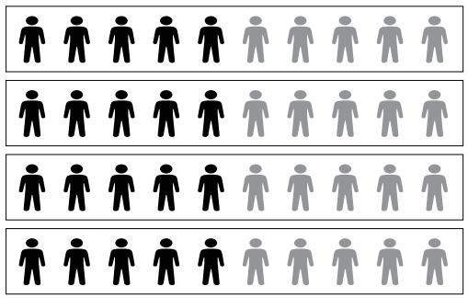
How many people are at this event?

Slide 3
How many people are at this event?

Slide 4
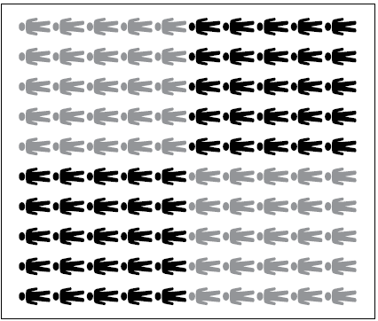


0
3
6
5
Hundreds | Tens | Ones

Slide 5
0
3
6
5
Hundreds | Tens | Ones
How many tens are in all of the number 365? Where are the tens?
How many fives are in all of 365?
How many more people must be added to make 500?

