Slide 1
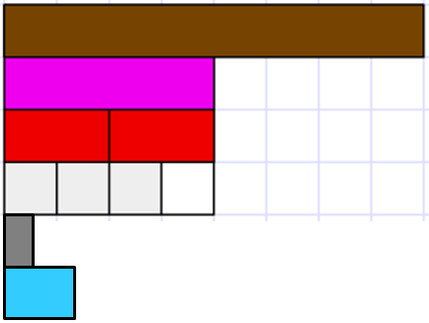
How are the grey and pale blue rods related to one?
How are those fractions related to one half?
Lesson One: Slide One

Slide 2
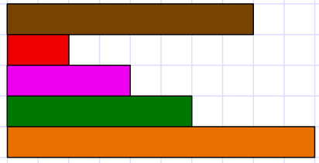
Investigation One
Imagine that the brown rod is one.
What names will you give to the other rods?
Justify why your name for each rod.

Slide 3
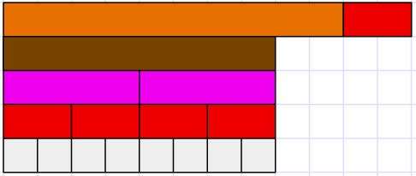
It
It
But two thirds is 66%. That means 66 out of 100.
100 is not a multiple of three so you’re wrong.
Every fraction equivalent to two-thirds has a multiple of three as the denominator. It has to be that way.
Lesson One: Slide Three

Slide 4
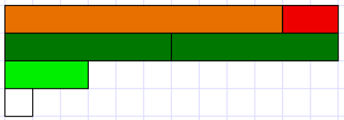
Investigation Two
Imagine that the golden rod is one.
What names will you give to the other rods in your set?
What equivalent fractions can you find?

Slide 5
Investigation Three
Here are combinations of different rods that add to the gold rod.
What equations could we write about those combinations?
Find some combinations of different rods that add to the gold rod and record equations about those combinations?

Slide 6
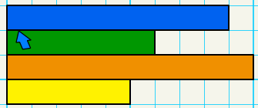
Investigation Four
Use these rods to create some subtraction problems about difference between fractions.
Remember that you can make up a one rod if you want to.

Slide 7
Investigation Five
0
Use the orange rod as two thirds and the blue rod as three fifths.
Where is one?
What other fractions can you locate on this number line?

Slide 8
Investigation Six
0
$$\frac{1}{5}$$
$$\frac{2}{3}$$
$$\frac{3}{4}$$
The red rod is the difference between two thirds and three quarters.
Where is one?
What other fractions can you locate on this number line?

Slide 9
Investigation Six
$$\frac{3}{5}$$
$$\frac{3}{4}$$
The light green rod is the difference between three fifths and three quarters.
Where is one? Where is zero?
What other fractions can you locate on this number line?

