Slide 1
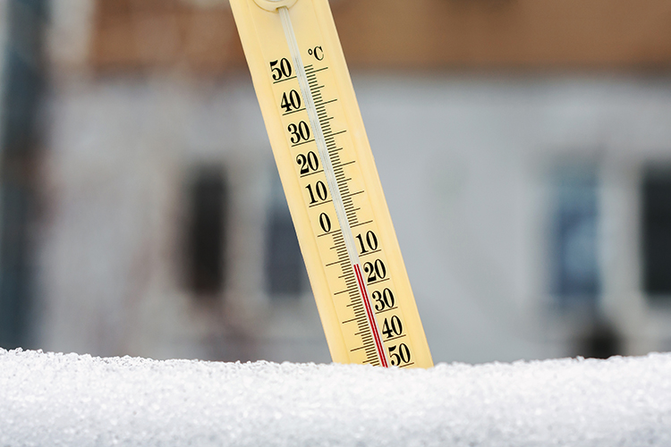
This thermometer is outside on a cold winter day
What is the temperature?

Slide 2
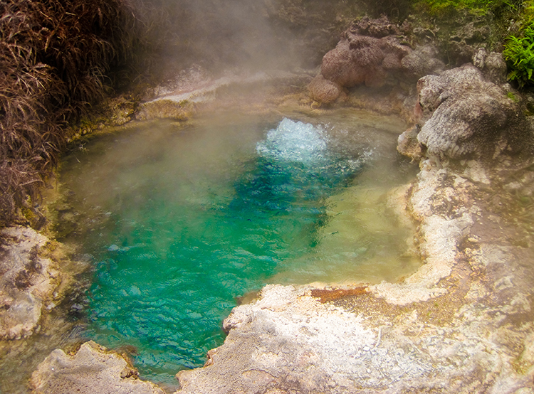
What is special about the temperature 100⁰C?

Slide 3
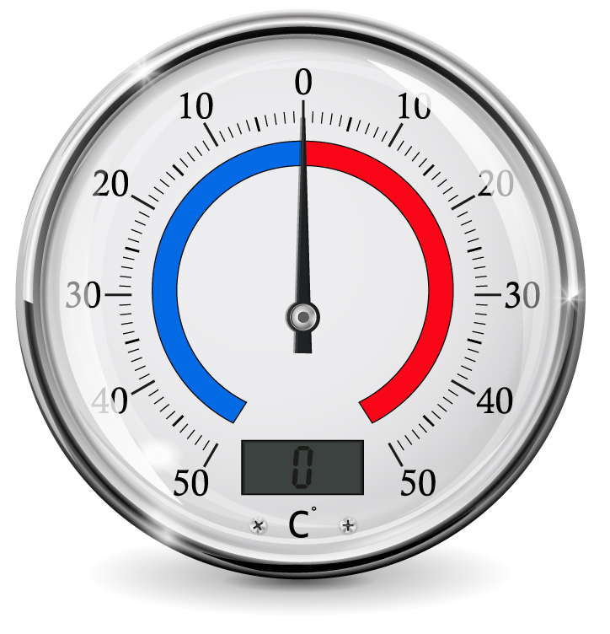
What is special about the temperature 0⁰C?

Slide 5
⁰C
100
50
0
⁻50
⁻100

Slide 6
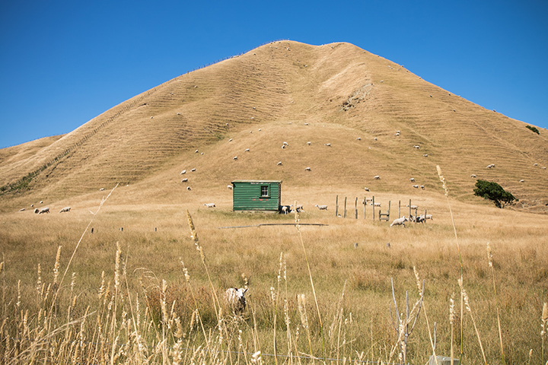
A very hot summer day in Poverty Bay.
The temperature is 36⁰C?

Slide 7
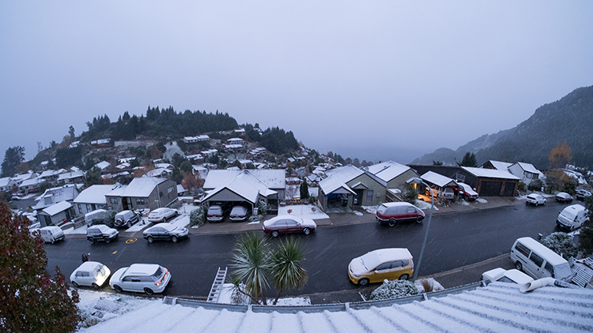
It is bitterly cold in Queenstown.
The temperature is ⁻5⁰C?

Slide 8
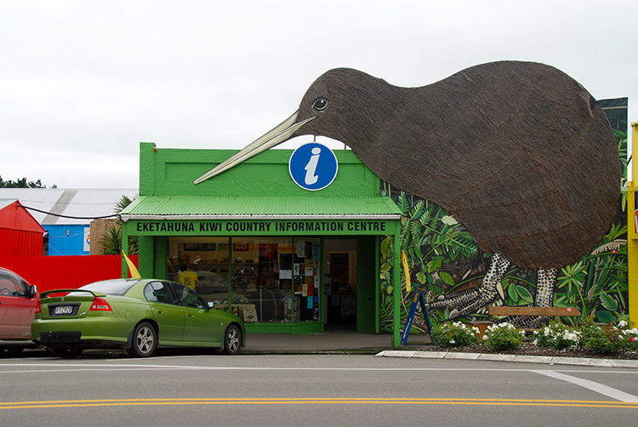
Where in New Zealand is Eketahuna?
The temperature on this spring day is 14⁰C?

Slide 9
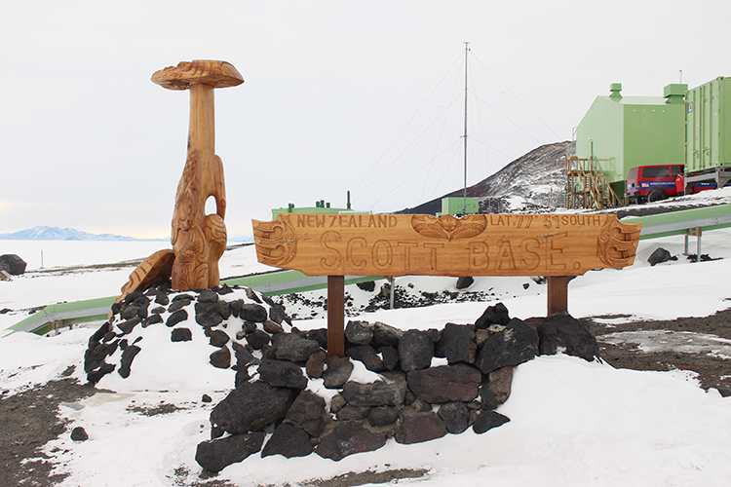
This is Scott Base. Where is it? August is the coldest month at Scott Base.
The daily temperature varies between ⁻23⁰C, at the warmest time of the day, to ⁻37⁰C , at the coldest time.
How many degrees does the temperature vary, in one day?

Slide 10
⁰C
100
50
0
⁻23
⁻37
⁻50
⁻100

Slide 11
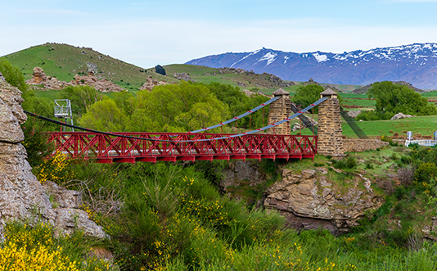
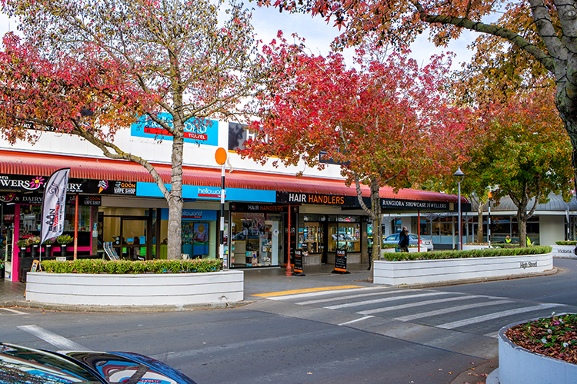
The lowest air temperature ever recorded in New Zealand was at Ophir, in Central Otago.
On 3 July, 1995, the thermometer reached a low of ⁻22⁰C.
The highest air temperature ever recorded in New Zealand was at Rangiora, in North Canterbury.
On 7 February, 1973, three places, including Rangiora, hit a scorching 42 ⁰C.
What is the difference, in degrees, between the two temperatures?

Slide 12
⁰C
100
50
42
0
⁻22
⁻50
⁻100

Slide 13
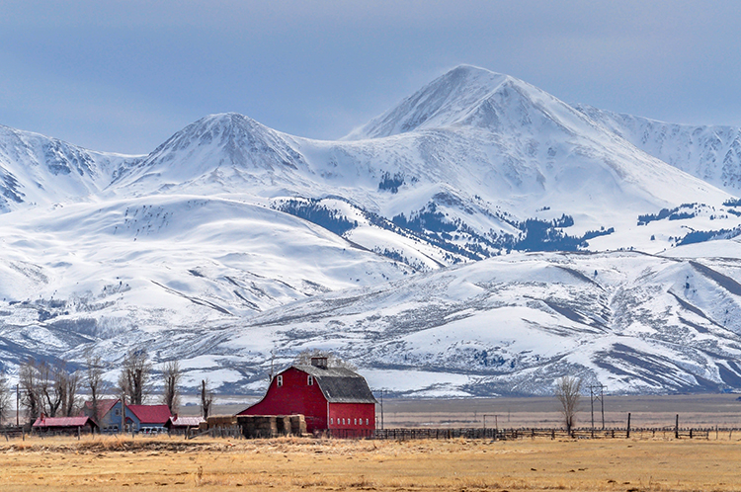
The biggest range in temperature for one place on a single day was recorded in Loma, Montana, on January 15, 1972.
The highest temperature that day was 9⁰C.
The lowest temperature was an amazing 57⁰C lower.
What was the lowest temperature that day?

Slide 14
⁰C
100
50
9
0
- 57
⁻50
⁻100

Slide 15
Investigate.
Why do parents and doctors often take your temperature when you are unwell?
If you have a temperature of 40⁰C should you seek medical advice?
Explain.

