Slide 1
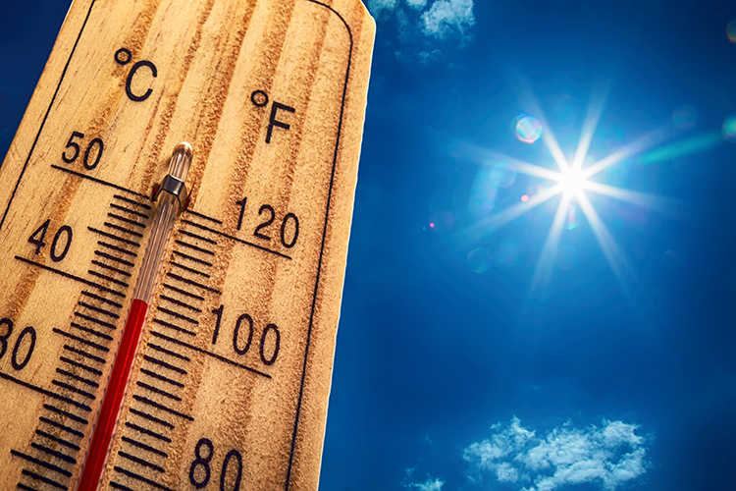

Slide 2
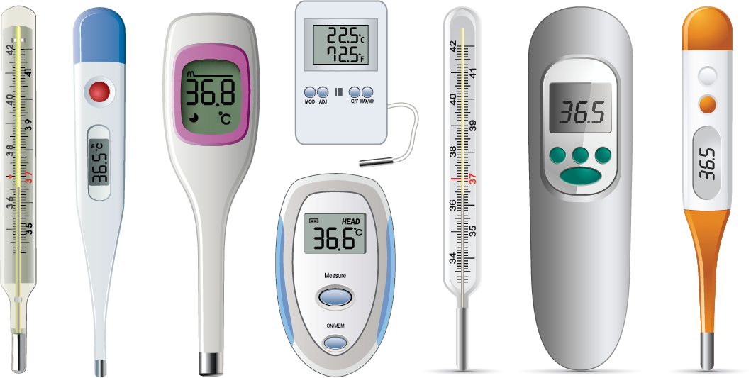

Slide 3




Slide 4
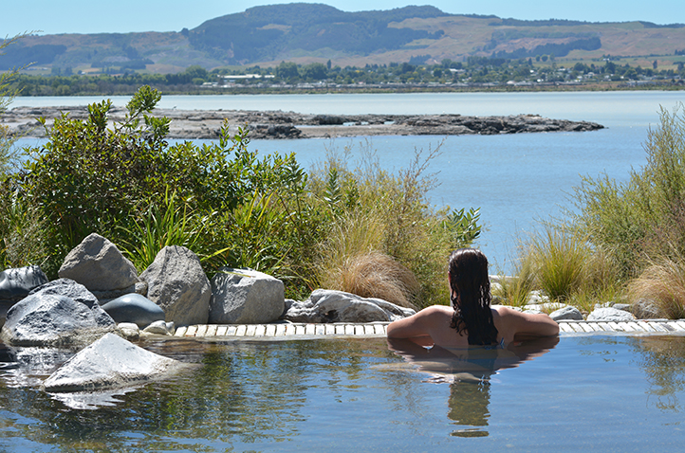
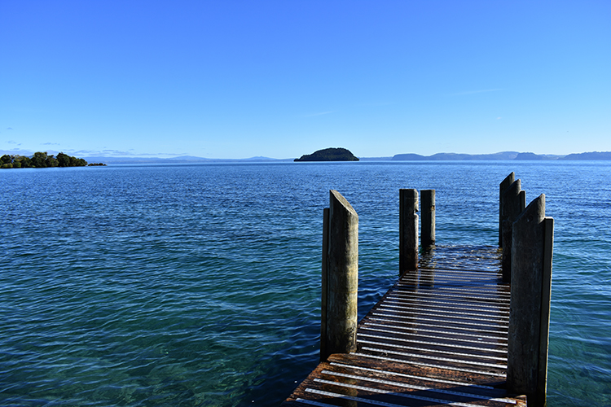
Bathing pool at The Polynesian Baths, Rotorua
Average temperature of water, Lake Taupō
32⁰C
10⁰C

