Slide 1
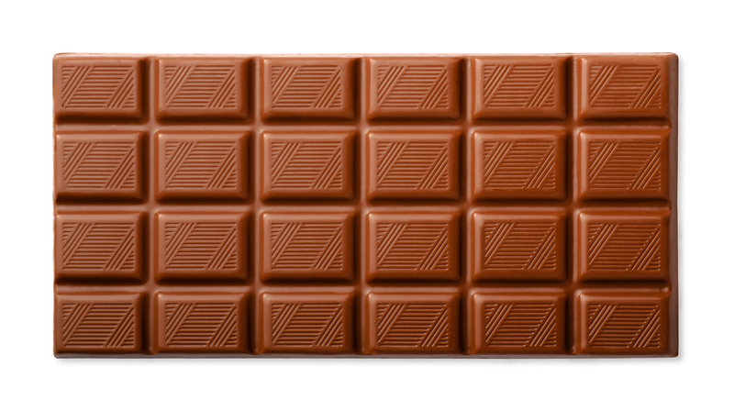
How many squares are in the whole bar?

Slide 2
How many red squares fill the blue rectangle?

Slide 3
How many squares are in the whole bar?

Slide 4
How many squares are in the whole bar?

