Slide 1

What details do you usually look for in mobile phone plans?

Slide 2

Flight
$49.99 per month
Get a phone interest free over 12 or 24 months
Data:
Minutes:
SMS:
10GB
120
Unlimited
Period:
Data Rollover:
Min. Rollover:
Data Hotspot:
Monthly
120
NA
No

Slide 3

1 kilobyte (1KB) equals 1 000 bytes.
1 Megabyte (1 MB) equals 1 000 kilobytes.
1 Gigabyte (1 GB) equals 1000 megabytes.
So how many bytes are in a gigabyte?

Slide 4
Flight
Flight
Flight
$25.00 per month
$38.00 per month
$57.00 per month
Spotify at half price
Spotify at half price
Spotify at half price
Data:
Minutes:
SMS:
1GB
Unlimited
Unlimited
Data:
Minutes:
SMS:
2.5GB
Unlimited
Unlimited
Data:
Minutes:
SMS:
5GB
Unlimited
Unlimited
Period:
Data Rollover:
Min. Rollover:
Data Hotspot:
Monthly
Yes
NA
Yes
Period:
Data Rollover:
Min. Rollover:
Data Hotspot:
Monthly
Yes
NA
Yes
Period:
Data Rollover:
Min. Rollover:
Data Hotspot:
Monthly
Yes
NA
Yes

Slide 5
Bolt
Bolt
Bolt
$33.00 per month
$33.00 per month
$33.00 per month
Spotify at half price
Spotify at half price
Spotify at half price
Data:
Minutes:
SMS:
3GB
120
Unlimited
Data:
Minutes:
SMS:
1.5GB
180
Unlimited
Data:
Minutes:
SMS:
4GB
80
Unlimited
Period:
Data Rollover:
Min. Rollover:
Data Hotspot:
Monthly
Yes
NA
Yes
Period:
Data Rollover:
Min. Rollover:
Data Hotspot:
Monthly
Yes
NA
Yes
Period:
Data Rollover:
Min. Rollover:
Data Hotspot:
Monthly
Yes
NA
Yes

Slide 6
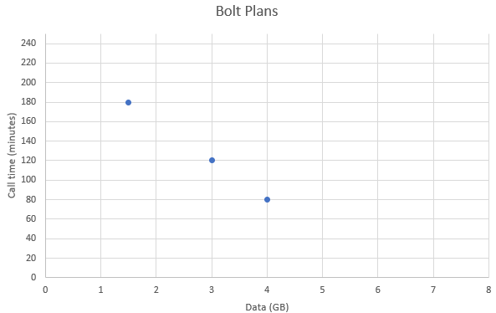

Slide 7
3Degrees
Flight
Bolt
$20.00 per month
$45.00 per month
$40.00 per month
Free phone cover
Interest free phone purchase
Endless data at slow speed after 3GB
Data:
Minutes:
SMS:
1GB
60
100
Data:
Minutes:
SMS:
3GB
Unlimited
Unlimited
Data:
Minutes:
SMS:
3GB
180
Unlimited
Period:
Data Rollover:
Min. Rollover:
Data Hotspot:
Monthly
No
NA
No
Period:
Data Rollover:
Min. Rollover:
Data Hotspot:
Monthly
Yes
NA
Yes
Period:
Data Rollover:
Min. Rollover:
Data Hotspot:
Monthly
No
NA
Yes
Modaphone
Catapult
Tinny
$30.00 per month
$25.00 per month
$25.00 per month
Bonus data of 1GB per month
4 person free calls at $5 per month
Data:
Minutes:
SMS:
2GB
120
Unlimited
Data:
Minutes:
SMS:
1.5GB
Unlimited
150
Data:
Minutes:
SMS:
2.5GB
90
Unlimited
Period:
Data Rollover:
Min. Rollover:
Data Hotspot:
Monthly
No
NA
Yes
Period:
Data Rollover:
Min. Rollover:
Data Hotspot:
Monthly
Yes
NA
No
Period:
Data Rollover:
Min. Rollover:
Data Hotspot:
Monthly
No
NA
Yes

