Slide 1
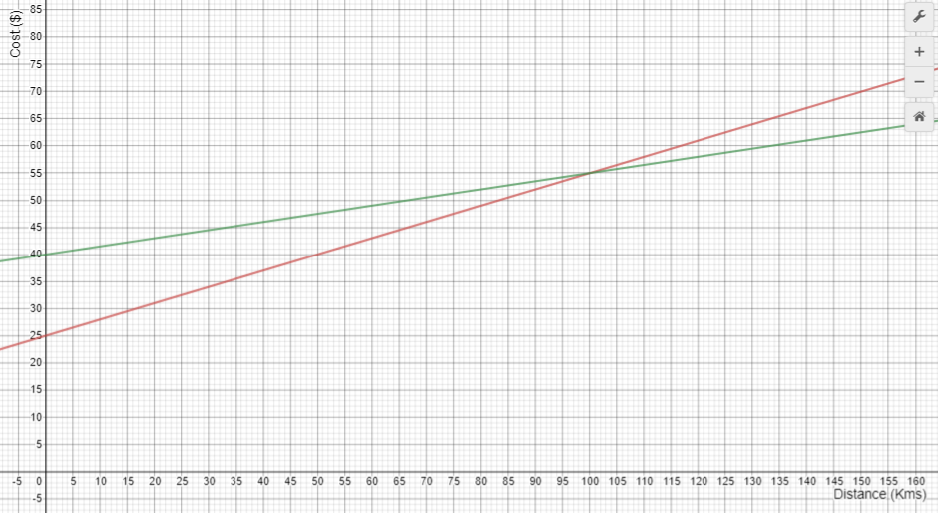
Which company belongs to each line? How do you know? Label the lines.
Which company is cheapest if you only want to travel only 80 kilometres? How do you know?
What does the intersection of the lines mean?
Which company is the cheapest to hire from, for one day?

