Slide 1
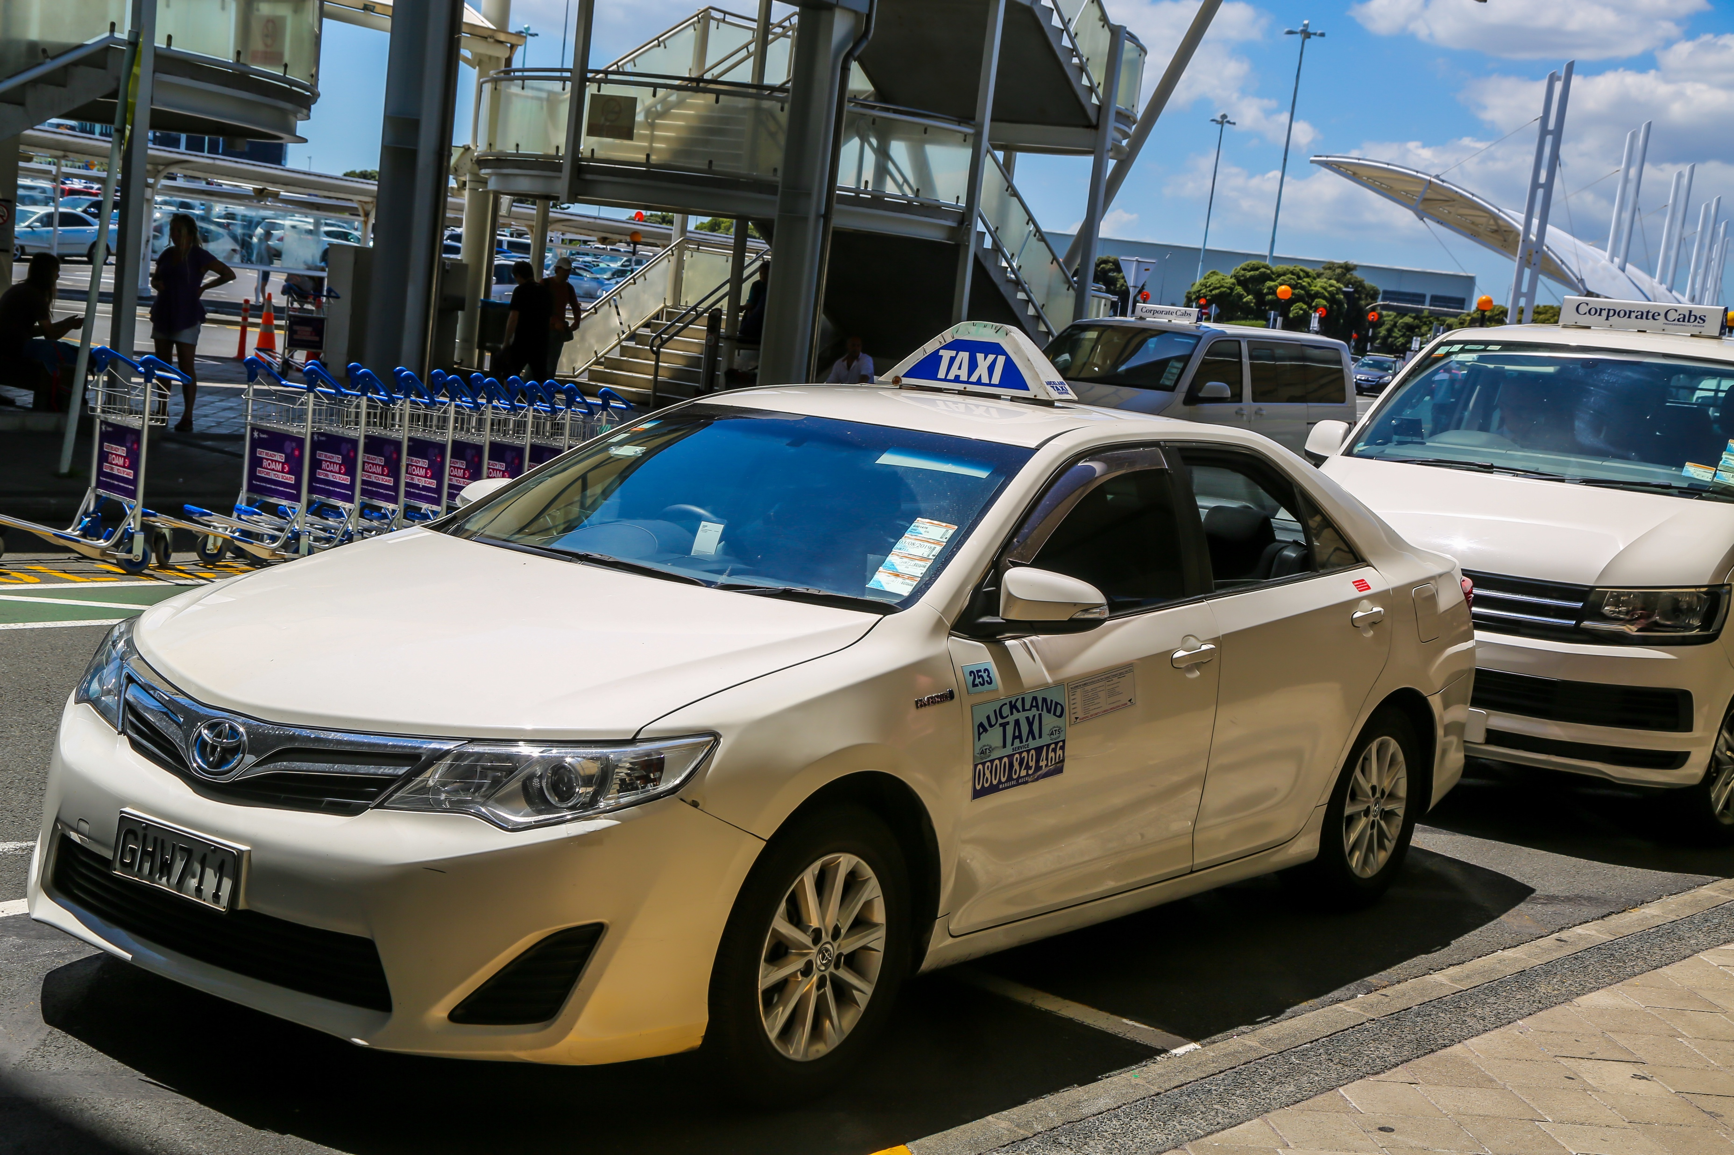
What do you know about hiring a taxi?

Slide 2
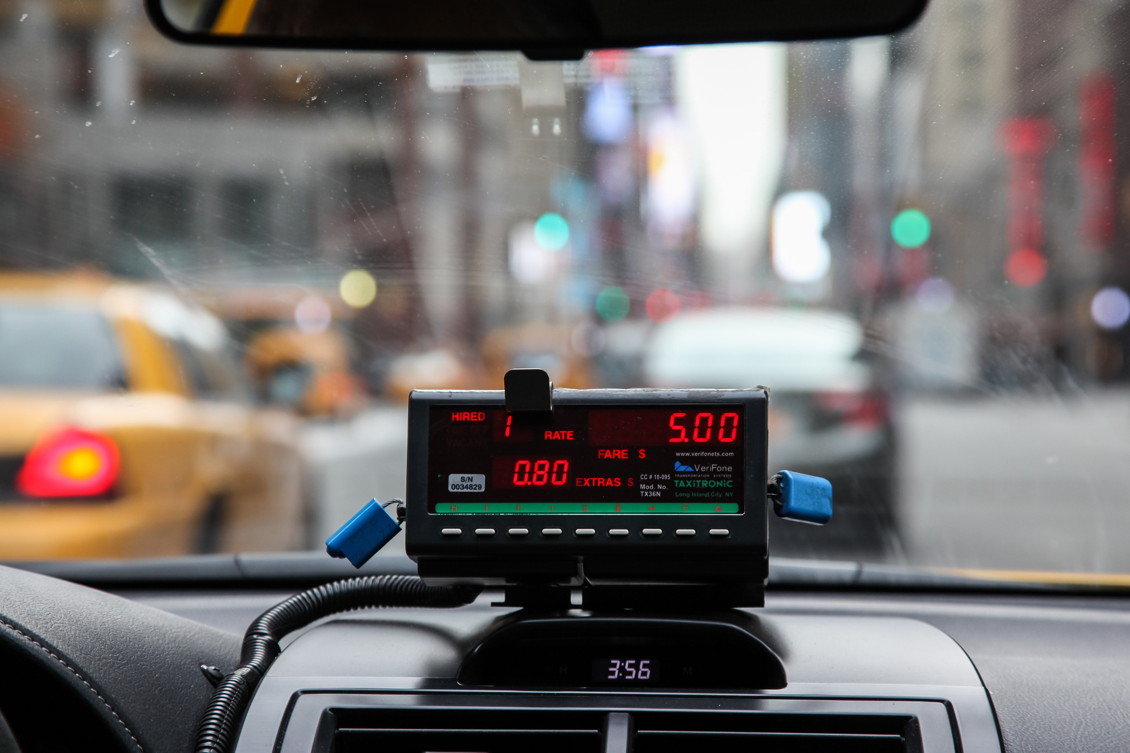
What is this device? What does it do?

Slide 3
Tiki Taxis charge $5 flag fall and $3 per kilometre.

Slide 4
How much would it cost you to travel 25 kilometres in the cab?
How much would it cost you to travel 32 kilometres in the cab?
How far could you go for $41?
How far could you go for $77?

Slide 5
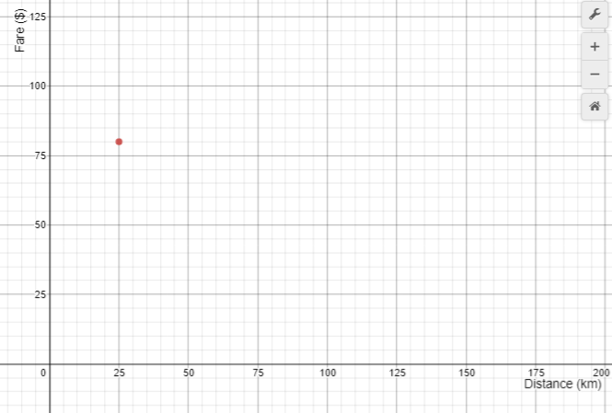
Tiki Taxi Fares

Slide 6
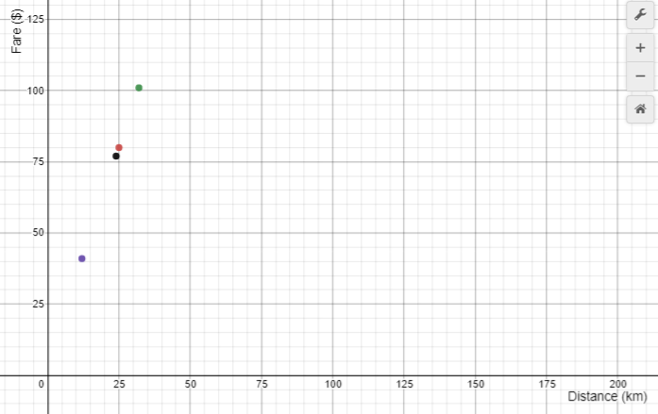
Tiki Taxi Fares

Slide 7
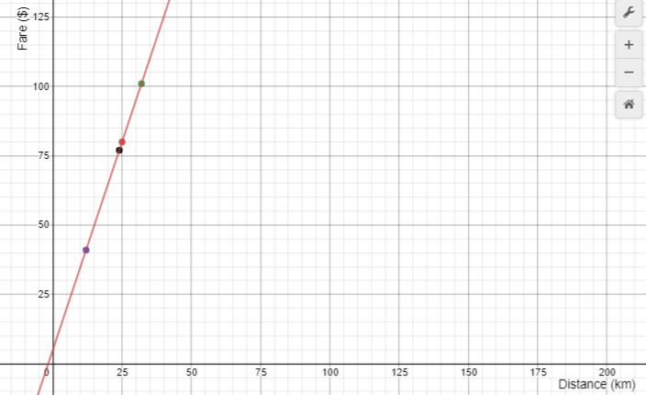
Transit Taxi Fares

Slide 8
Transit Taxis find they are not making enough money to cover their costs,
and to give their drivers a decent wage.
Which option is better, for the company to make more money?
Raise flagfall to $10.00, or
Increase the rate to $3.50 per kilometre

Slide 9
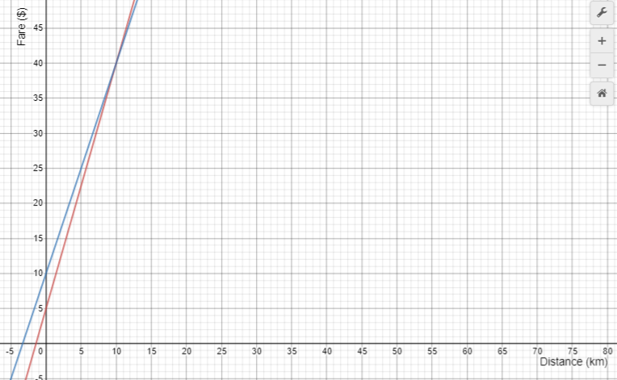
Tiki Taxi Fares

