Slide 1
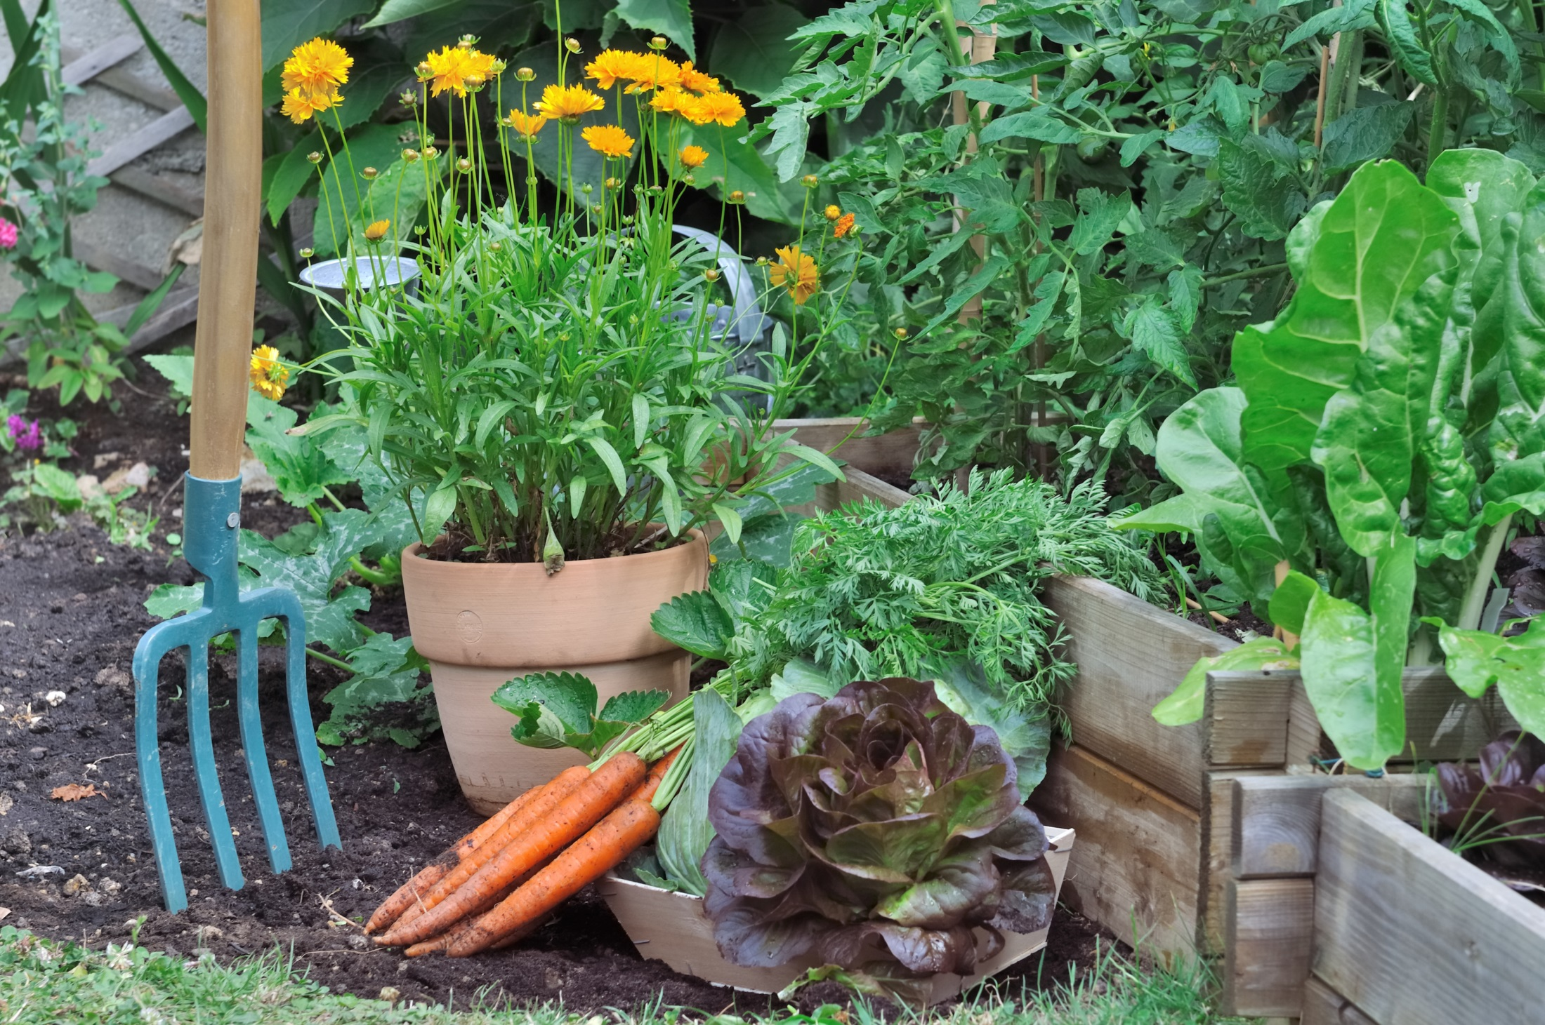
Farmer Joe’s growing vegetable patch.

Slide 2
Yap’s master, Farmer Joe, has a growing vegetable patch at the farm. Every year he makes the patch larger because he thinks of new plants to grow.
This is the patch in Year Four. Each brown square represents 1m².
Find an efficient way to work out the area of the vegetable patch.

Slide 3
If you saw the patch this way, what equation would you write?

Slide 4
If you saw the patch this way, what equation would you write?

Slide 5
If you saw the patch this way, what equation would you write?

Slide 6
If you saw the patch this way, what equation would you write?

Slide 7
Here are pictures of Farmer Joe’s garden for Years Three and Four.
What did the garden look like in Years One and Two?
What will the garden look like in Year Five and Six?
Find a way to show the area of each garden without drawing every square metre.
Year Three
Year Four

Slide 8
Imagine that Farmer Joe made his garden bigger in that pattern.
What would the area of his garden be in Year 12?

