Slide 1
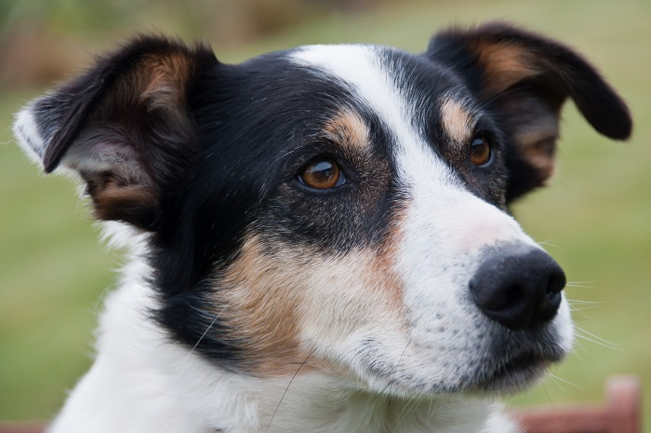
Megabytes
Meet Yap the sheepdog.
He gets very hungry after a day’s work rounding up sheep.

Slide 2
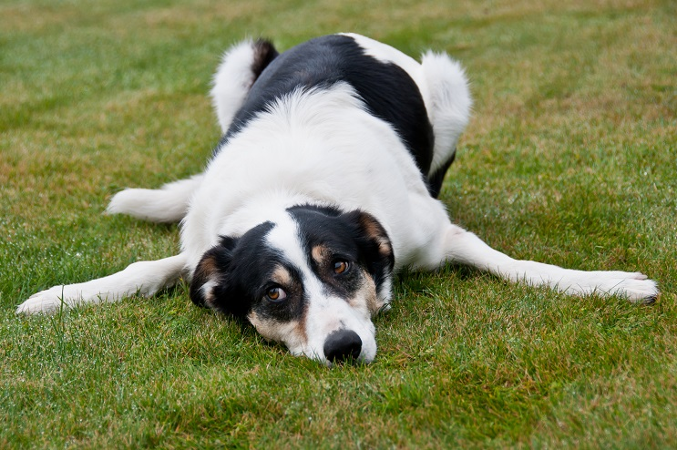
Why do they keep changing my biscuits? These new biscuits are smaller. I am going on strike.
Sheepdogs like routine and Yap is a bit upset that his dog biscuits do not look the same size as they used to be.

Slide 3
Chomp Biscuit
Bonza Biscuit
Is Yap right?
Is the old Chomp bigger than the new Bonza biscuit?
How could he tell?

Slide 4
Chomp Biscuit
Bonza Biscuit

Slide 5


Yap the Sheepdog
“The Willows”
Main Road
Mapiu.
Working Dog Biscuit Co. Ltd
47 Meatytreat Lane
Te Kuiti
Dear Biscuit Maker
I recently measured my favourite dog biscuits ‘Chomp’. They are exactly 36 squares in area.
So please do not trick me again by changing the shape of your biscuits.
I am on to you!
Signed
Yap

