Slide 1
Write two multiplication equations for this array of pūkeko.
$$3×8=24$$
$$8×3=24$$

Slide 2
Write two division equations for the same array of pūkeko.
$$24÷8=3$$
$$24÷3=8$$

Slide 3
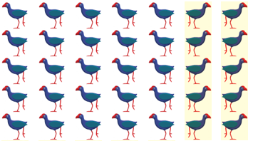
Write two multiplication equations for this array of pūkeko.
$$5×7=35$$
$$7×5=35$$

Slide 4
Write two division equations for the same array of pūkeko.
$$35÷7=5$$
$$35÷5=7$$

Slide 5
Write two multiplication equations, and two division equations, for this array of pūkeko.
$$3×9=27$$
$$9×3=27$$
$$27÷9=3$$
$$27÷3=9$$

Slide 6
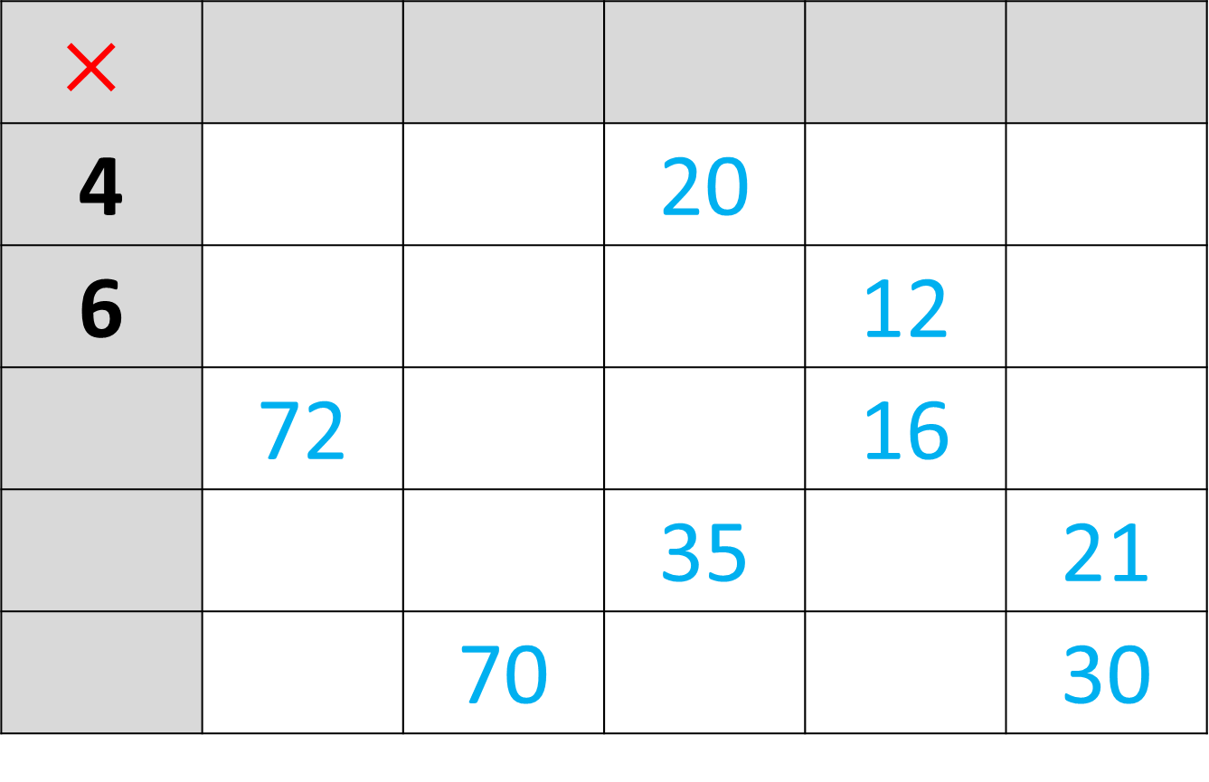
5
$$×$$
4 |  |  | 20
6 |  |  |  | 12
 | 72 |  |  | 16
 |  |  | 35 |  | 21
 |  | 70 |  |  | 30
9
7
2
3
8
7
10

