Slide 1
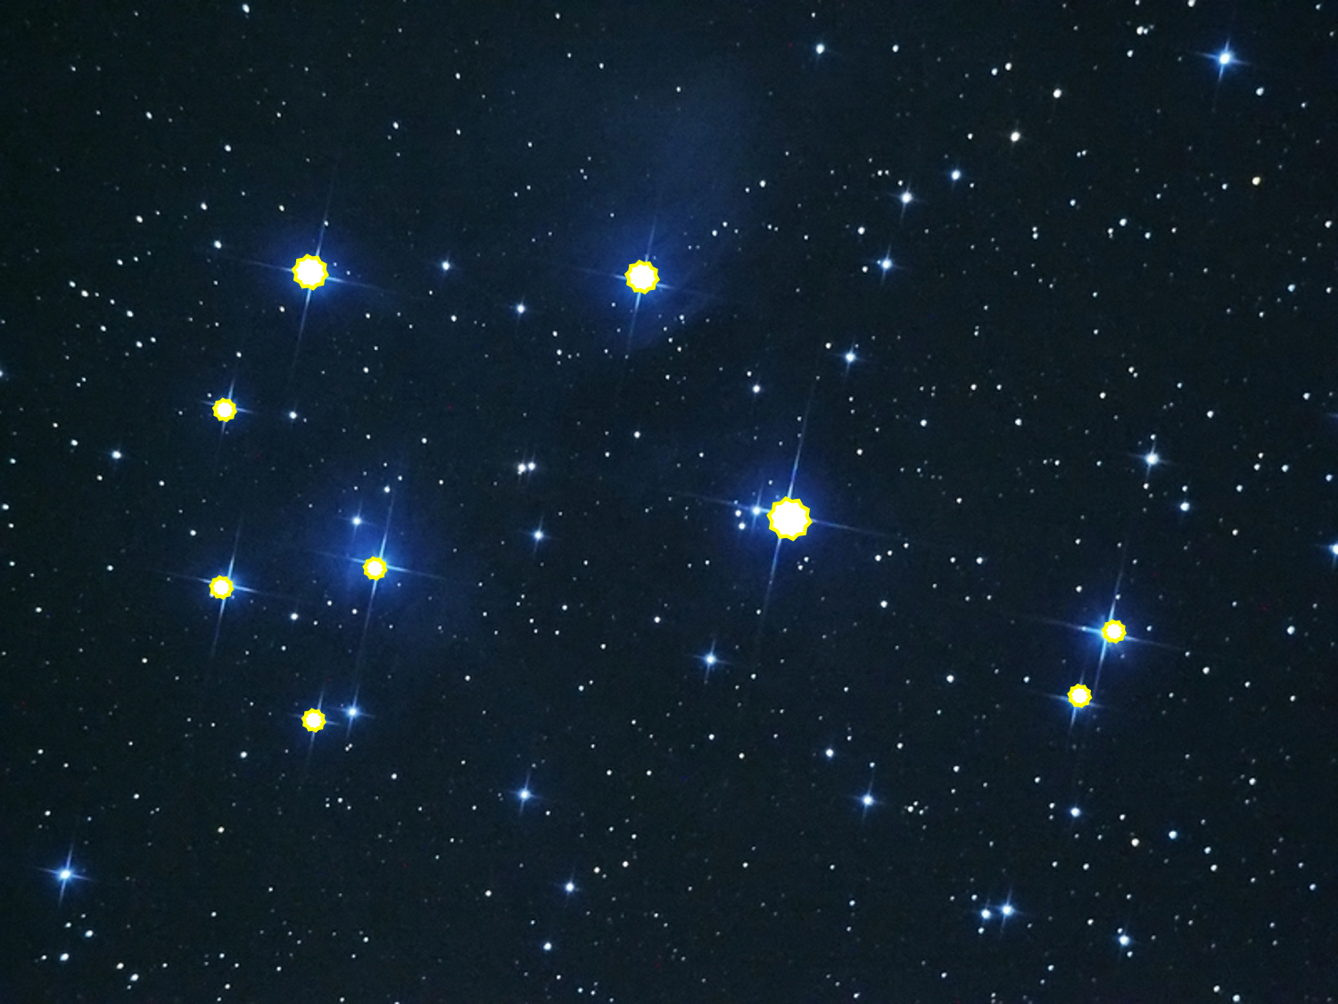
Do you know which whetu is which?

Slide 2
Clue Tahi
There are two pairs of stars.
Waitā and Waitī
Tupu-ā-rangi and Tupu-ā-nuku

Slide 3
Clue Rua
Waitā and Waitī and Matariki look like they are co-linear.
Matariki
Waitā
Waitī
Tupu-ā-nuku
Tupu-ā-rangi

Slide 4
Clue Ono
Rangi means sky and nuku is short for Papatūānuku, meaning Earth.
Waitī is closer to Matariki than Waitā.
Matariki
Waitā
Waitī
Waitā
Waitī
Tupu-ā-rangi
Tupu-ā-nuku
Tupu-ā-rangi
Tupu-ā-nuku

Slide 5
Waipunarangi
Clue Toru
Waipunarangi, Waitā and Waitī form the corners of a right-angled triangle.
Matariki
Waitī
Waitā
Tupu-ā-rangi
Tupu-ā-nuku

Slide 6
Waipunarangi
Clue Wha
Pōhutukawa and Waipunarangi are on the same arc with Matariki at the centre.
Matariki
Waitī
Waitā
Tupu-ā-rangi
Pōhutakawa
Tupu-ā-nuku

Slide 7
Clue Rima
Matariki, Waitā, Ururangi and Waipunarangi almost form the corners of a trapezium.
Waipunarangi
Ururangi
Hiwa-i-te-rangi
Matariki
Waitī
Waitā
Tupu-ā-rangi
Pōhutakawa
Tupu-ā-nuku

Slide 8
Waipunarangi
Ururangi
Hiwa-i-te-rangi
Matariki
Waitī
Waitā
Tupu-ā-rangi
Pōhutakawa
Tupu-ā-nuku

