Slide 1
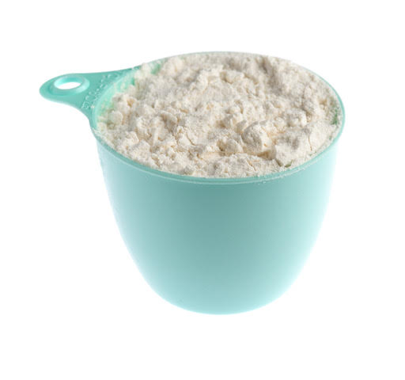
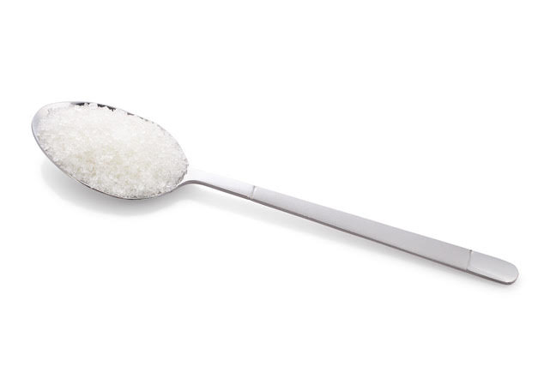
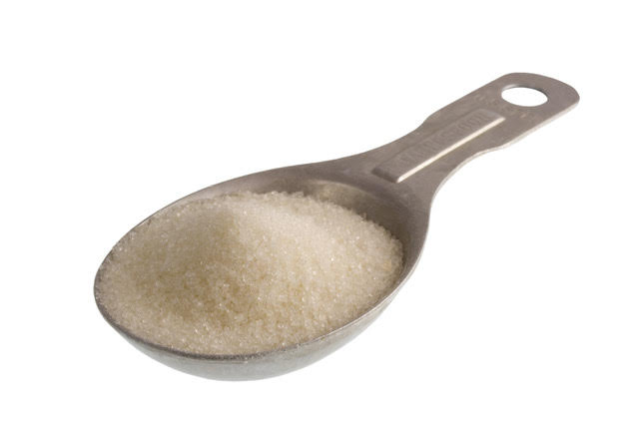
Rewena bread recipe
Mix these dry ingredients in a bowl.
4 tablespoons of sugar
5 cups of flour
1 teaspoon of salt

Slide 2
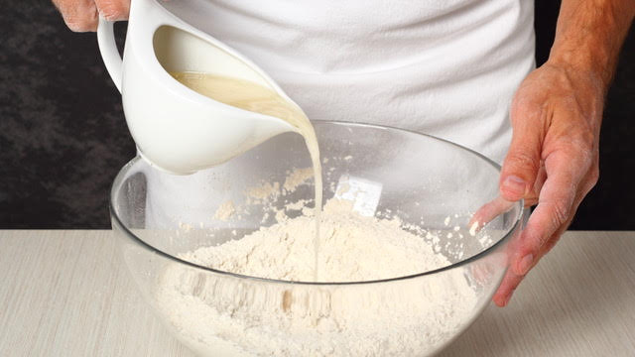
Make a well in the middle of the bowl.
Pour in half of a litre of ‘the bug’.

Slide 3
Mix up the dough using a spoon.
The dough should be a bit sticky.

Slide 4
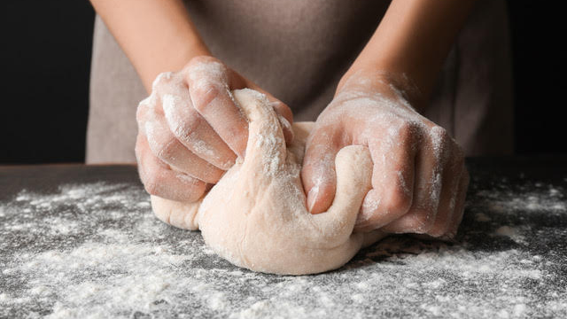
Put some flour on the table top.
Knead your dough for no more than ten minutes.
You may have to put a little water into the mix so it stays sticky.

Slide 5
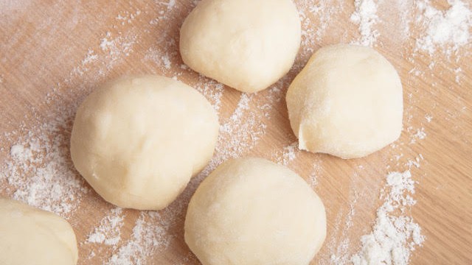
Make a cake using all your dough.
Cut the cake into quarters and make them into balls.
Put the quarters in a big, clean bowl.
Leave the pieces to rise for a few hours in a warm place.

Slide 6
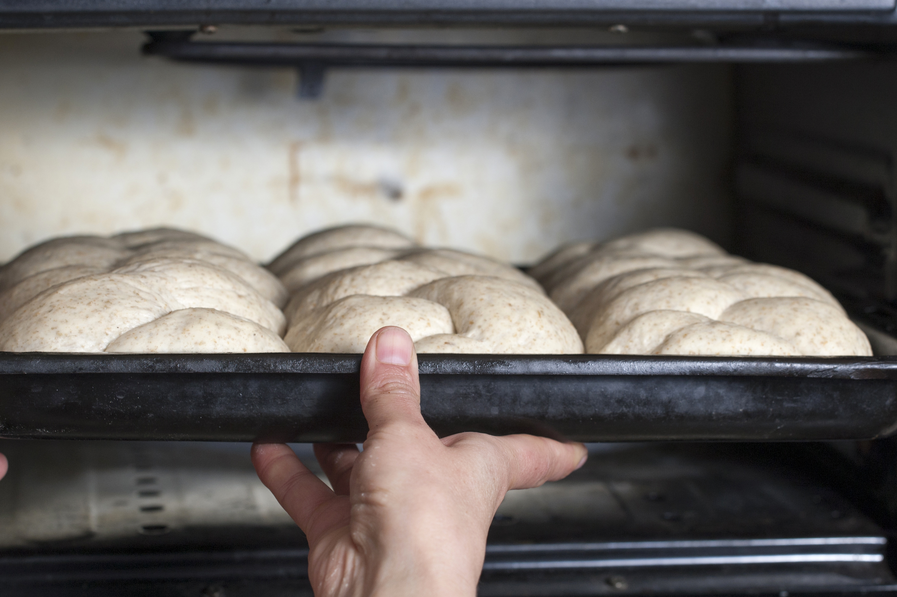
Knead the pieces again for a short time.
Put them into a baking tin. Bake in the oven at 200⁰C for 45-50 minutes.
Test that the bread is cooked by poking in a skewer.

