Slide 1
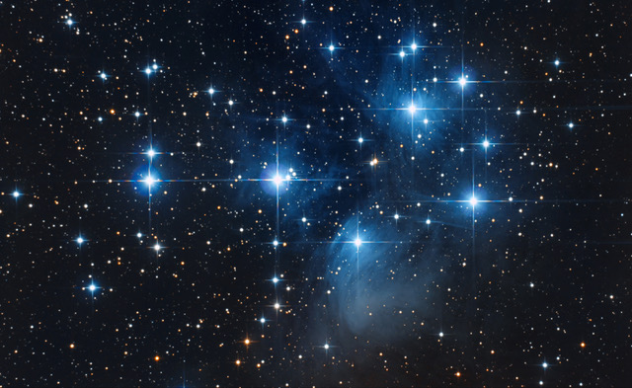
What are stars?
Where do you see them?
When do you see them?
Are they still there during the day?

