Slide 1
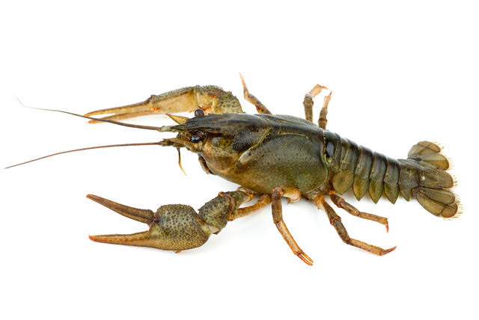
A
C
E
B
D
0
1
2
4
8

Slide 2
The offer is two koura.
A
D
E
0
2
4

Slide 3
The offer is three koura.
A
C
D
E
0
1
4
8

Slide 4
The offer is four koura.
A
B
C
D
0
1
2
8

