Slide 1
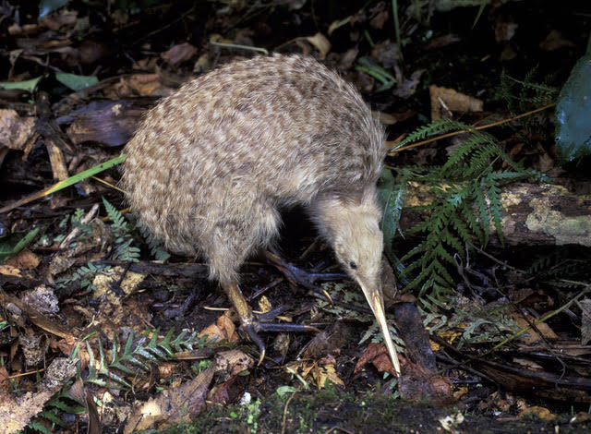
We have about 68 000 kiwi left but lose 2% of the unprotected birds each year, mainly due to introduced animals like pigs, dogs, cats, stoats and rats.

Slide 2
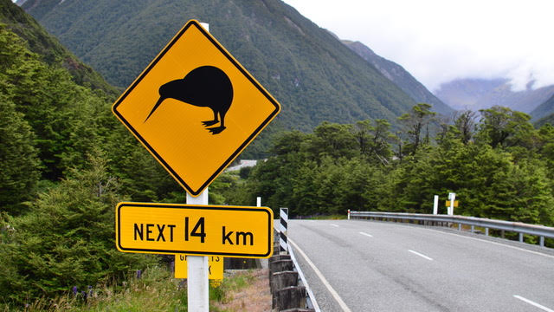
Female kiwis generally only lay only one egg in a clutch (litter) though the brown kiwi can lay 2-3 eggs. Being slow breeders puts the kiwi in danger of extinction.

Slide 3
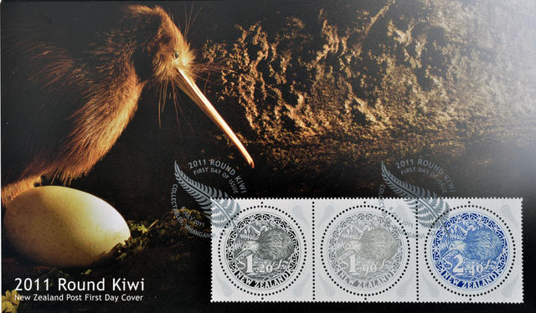
Assume there are only 50 fertile female kiwi left in New Zealand and they are all protected. There are also 50 fertile male kiwi. Half of the chicks that hatch are male and half are female.

Slide 4
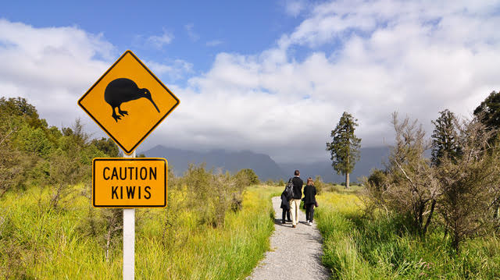
Assume a female begins laying in her third year of life and she lays two eggs per year for the next 15 years. Find a way to predict the number of kiwi after 15 years, if we protect them all.

