Slide 1
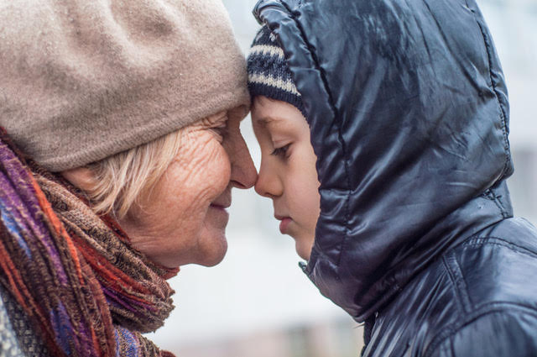
Every Sunday Tipene visited his kuia (Grandmother).
She was very old and wise beyond her many years.

Slide 2
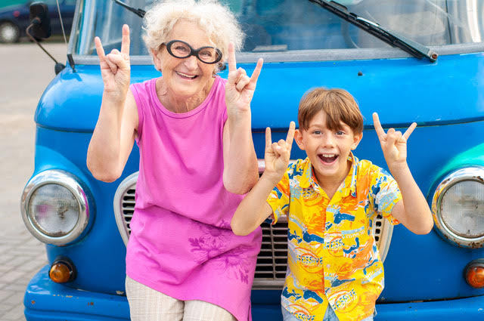
In summer they would pile into her Volkswagen Kombi and go to the beach for a surf, or picnic on the river bank. Kuia loved the outdoors and wanted Tipene to feel the same adoration for nature that she did.

Slide 3
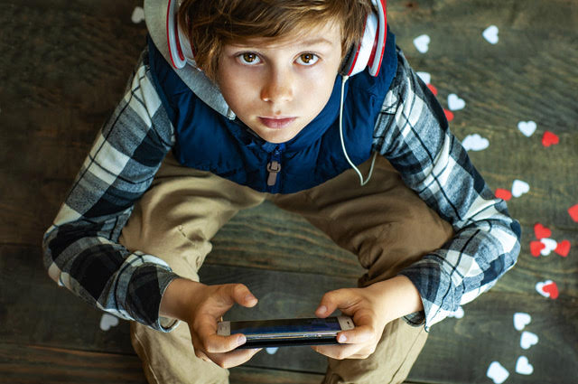
Kuia noticed that Tipene entertained himself with video games. Given a choice he would spend endless hours furiously tapping buttons with wide eyes glued to the screen.

Slide 4
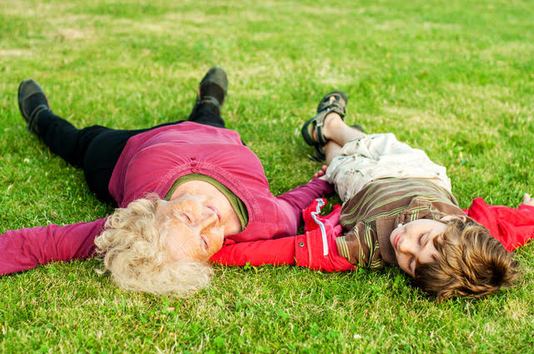
As they lay watching clouds drift by, Kuia gave Tipene a ka maia (dare).
“Each day before you play your video games, I want you give some people a gift of kindness. The gift can be as small or as large as you like. For example you might hang out washing for your mother, or give a friend your extra sandwich.”

Slide 5
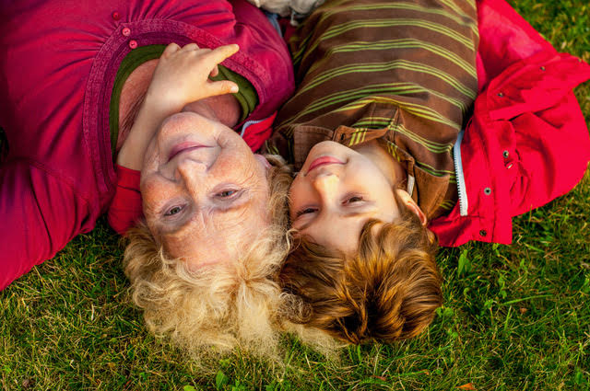
Kuia went on, “On the first day you give one person a kindness, on the second day two people, on the third day four people, and so on. Each new day you give twice as many people a kindness as the day before.”
“I’ll see you next Sunday,” replied Tipene thinking that the mahi (task) would be easy, “I’ll let you know how I got on.”

