Slide 1
You might have heard people talk about growing their money by putting it into a savings account.
What do they mean?

Slide 2
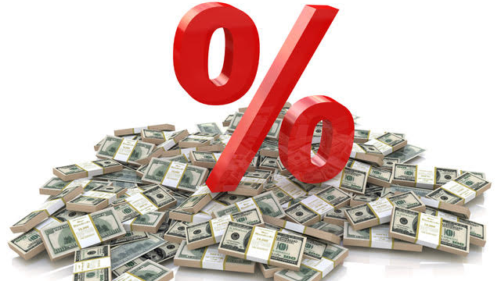
Banks give you interest on the money you have in an account.
What does an interest rate of 10% per annum mean?

Slide 3
Interest compounds every year.
That means you get interest on the new amount, not just the amount you first put in.
Suppose that you deposited $1,000 at an interest rate of 10% p.a.
How much would you expect to be in the account after 5 years.

Slide 4
Watch the video to see how to set up a spreadsheet to calculate the interest.

Slide 5
Watch the video to see how to graph the relationship.

Slide 6
What pattern do you notice?
Year | Amount
0 | $ 1,000.00
1 | $ 1,100.00
2 | $ 1,210.00
3 | $ 1,331.00
4 | $ 1,464.10
5 | $ 1,610.51
1000 x 1.1
1000 x 1.1 x 1.1
1000 x 1.1 x 1.1 x 1.1
1000 x 1.1 x 1.1 x 1.1 x 1.1

Slide 7
Start with the original amount of $1,000.
Investigate what happens to the amount in the account after 10 years as the interest rate varies.
You might try 2%, 5% and 20%.
What is the effect of changing the interest rate?

Slide 8
What is the effect of doubling the interest rate on the amount after ten years?
Why does this happen?

