Slide 1
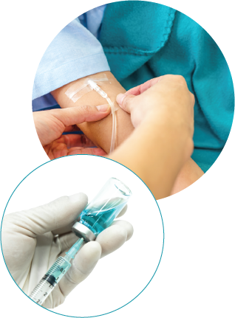
Another example of exponential ‘growth’.
If you go into hospital for an operation you are likely to have a lure inserted. Then the medical professionals can inject drugs, like anesthetics and antibiotics, directly into your bloodstream.
Plasma in the blood carries the drug around your body.

Slide 2
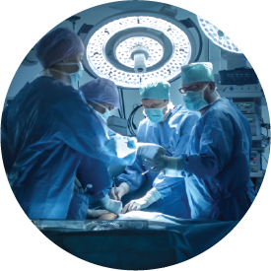
Monitoring the amount of a drug in the bloodstream is very important to the success of an operation. Too much can be as harmful as too little.
That is where mathematics comes in handy!

Slide 3
Every drug has a half-life, that is the time it takes for a human body to use, or throw out, half of the amount in the bloodstream. Let’s imagine that an anaesthetic has a half life of one hour. Before the operation 100mg of the drug is injected into your bloodstream. Each blue circle represents 1mg.
Click to watch the animation.

Slide 4
Here is how to graph the half life function.

Slide 5
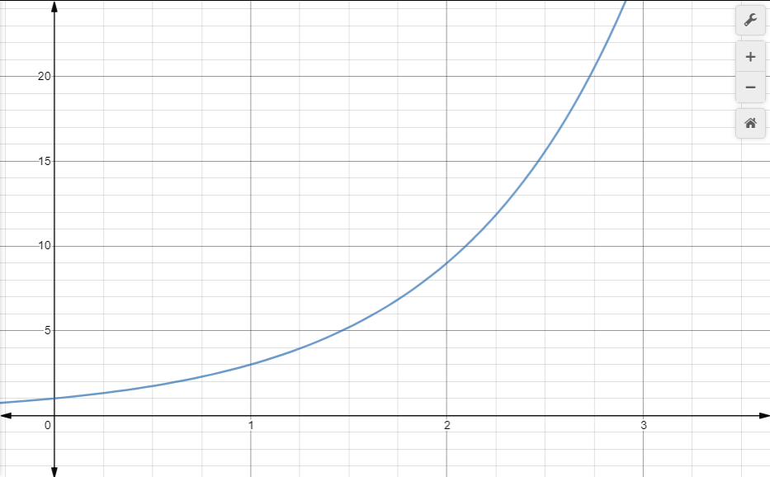
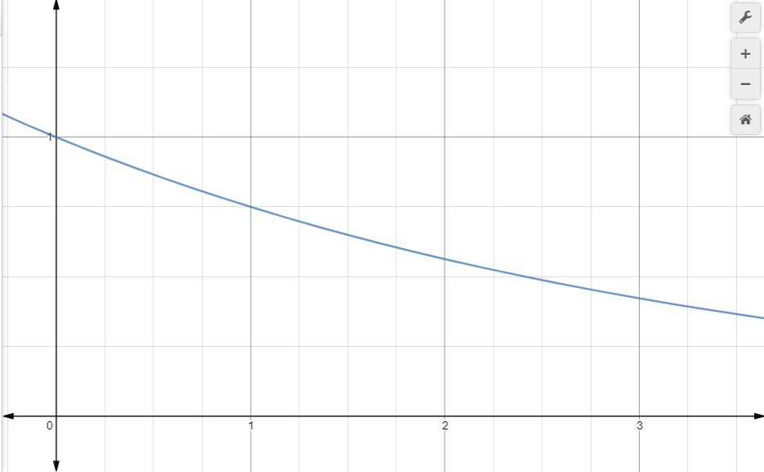
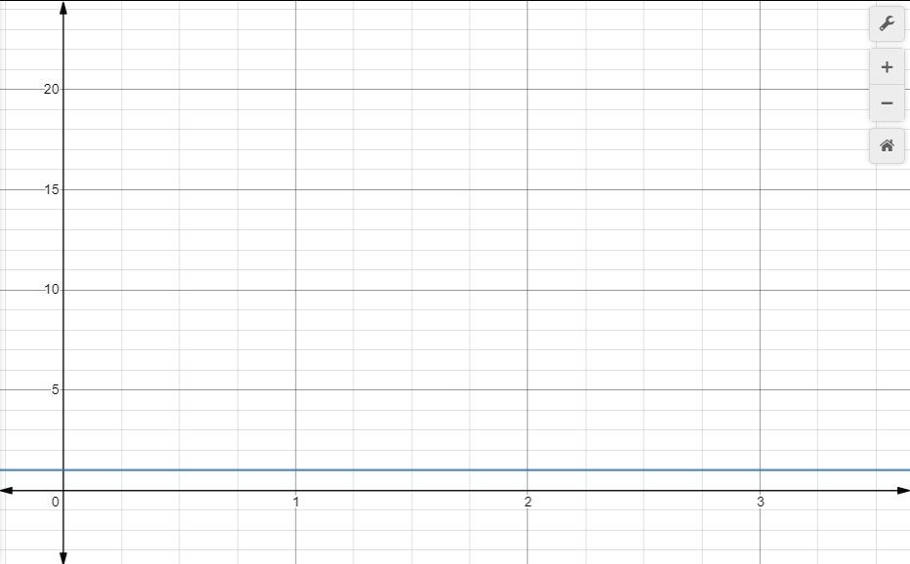
$$y=1^{x}$$
$$y=3^{x}$$
$$y={0.75}^{x}$$

