Slide 1
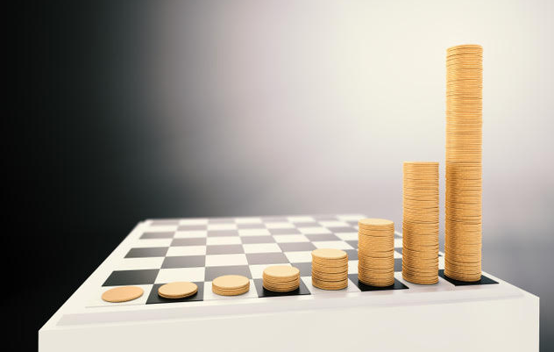
Natasha goes to a seminar on investment.
The presenter uses this slide to show how her money could grow if she invests it wisely.
What is the slide showing?

Slide 2
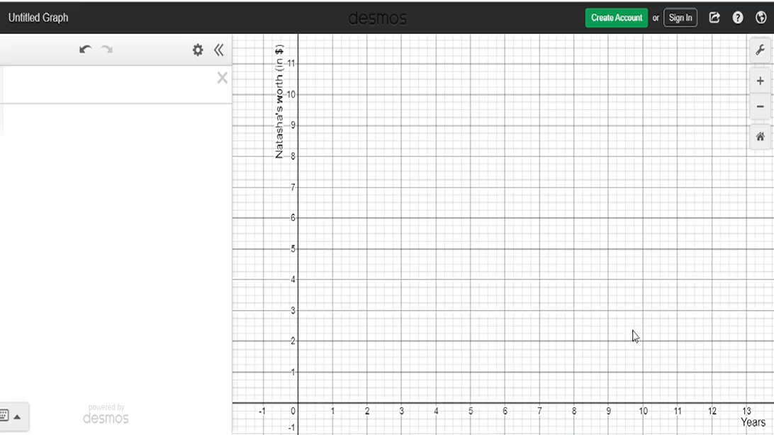
This video shows how to graph the growth of Natasha’s worth.

Slide 3
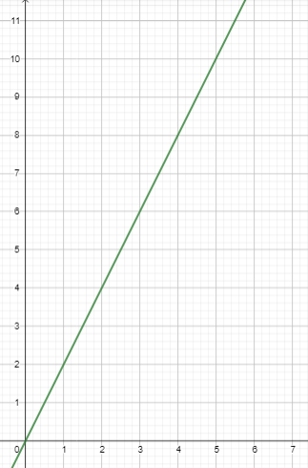
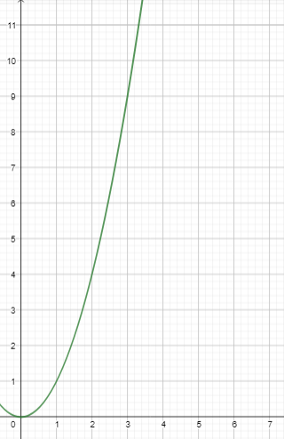


y values
y values
$$y=2x$$
$$y=x^{2}$$
x values
x values
Linear function
Quadratic function

Slide 4
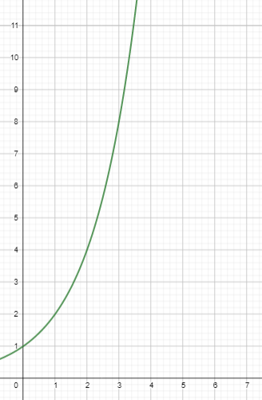

y values
$$y=2^{x}$$
x values
Exponential function

Slide 5
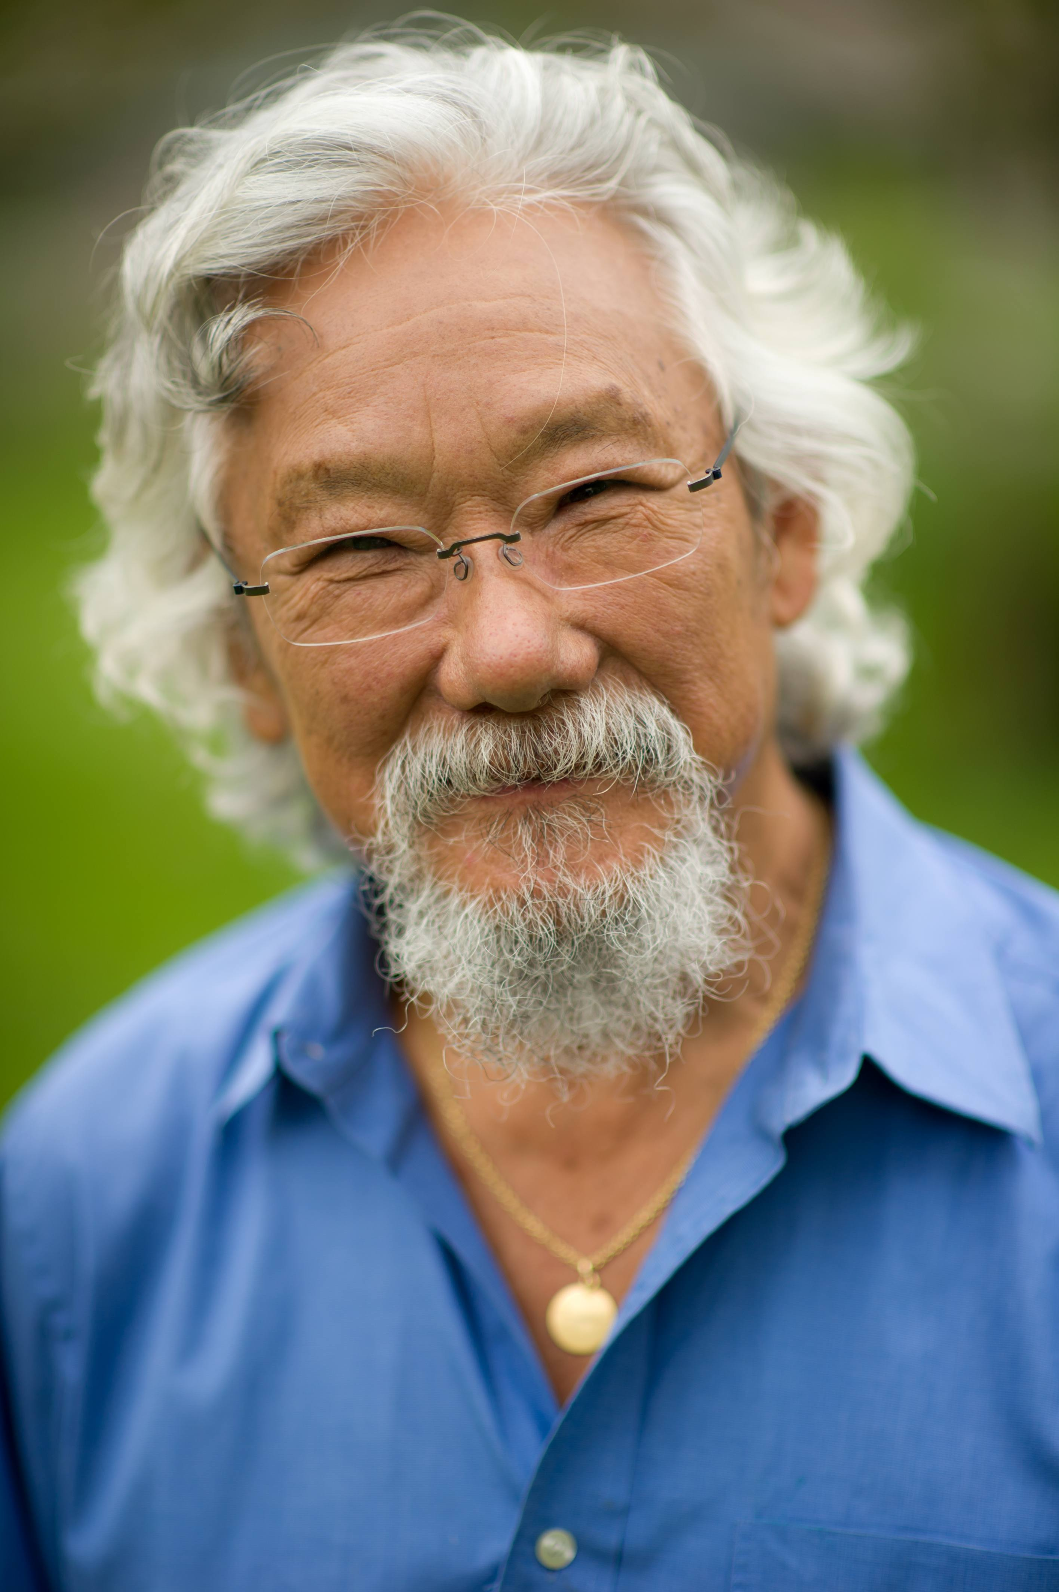
The next story comes from David Suzuki who is a Canadian environmentalist.

Slide 6
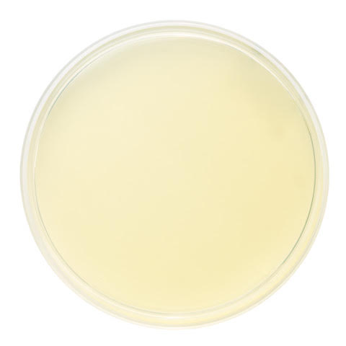
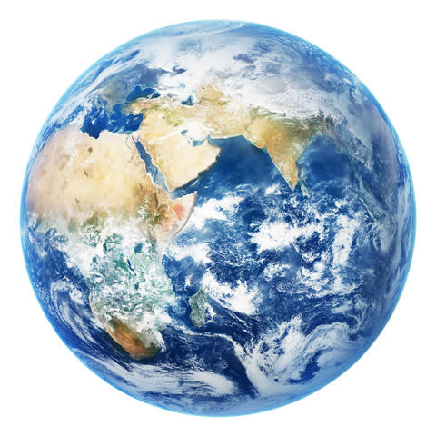

Imagine our planet is like a petrie dish full of agar (food).
The dish, like our planet, is finite (fixed) so it has a certain amount of food.
A scientist injects a single bacteria into the dish at minute zero.

Slide 7
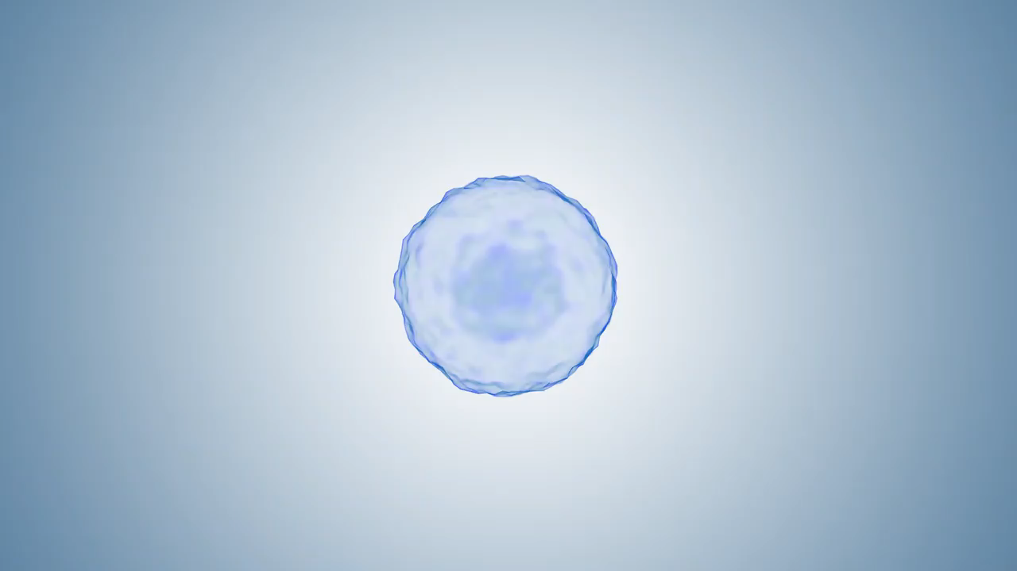
Bacteria are microscopic, single cell organisms.
Their numbers grow by splitting in two, a process called mitosis.
Doubling the number of bacteria doubles the food they need in total.

Slide 8
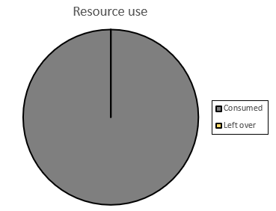
Suppose the number of bacteria doubles every minute.
For many minutes they need a very small percentage of the food in the petrie dish.
However, after 60 minutes there are so many bacteria that they need 100% of the food in the petri dish. That is the limit.

Slide 9
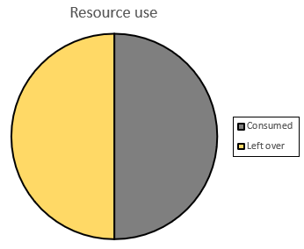
If the bacteria need all of the food at minute 60, what percentage so they need at minute 59? Discuss the answer then click the mouse.

Slide 10
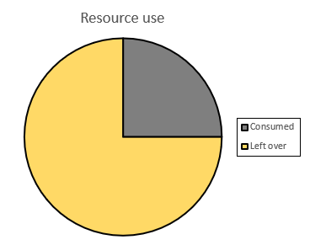
At minute 59, the bacteria need 50% of the available food.
What is the situation at minute 58? Discuss the answer then click the mouse.

Slide 11
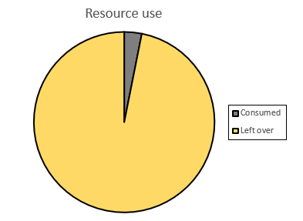
Predict the situation at minute 55. What percentage of the food do the bacteria need? Discuss the answer then click the mouse.
3.125%

Slide 12
Work with partner to answer these questions:
How are the bacteria like human beings, and the Earth like a petri dish?
What might a bacteria think at minute 55, if another bacteria said there was a population problem in the petrie dish? (Yes, we know bacteria cannot talk)
In David Suzuki’s story, a minute is the time it takes for the number of bacteria to double. Use the graph (Copymaster Two) to work out roughly how many years it takes for the human population to double.
4. What does the story mean for human beings and our planet?
What might people do that changes the story for the better?

Slide 13
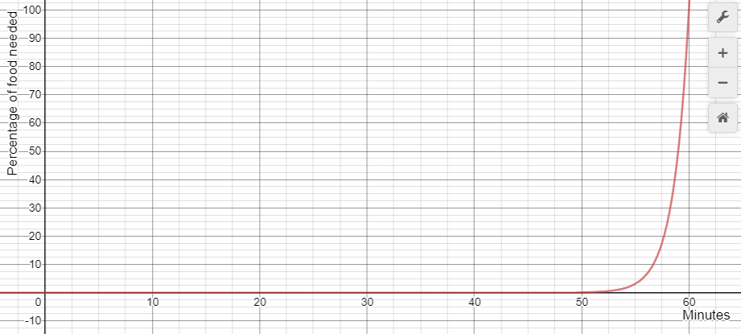
Here is a graph of the bacteria analogy. What features do you see in the graph?
Percentage of food needed by minute
Created using $y=\left(\frac{100}{2^{60}}\right)2^{x}$with Desmos Graphing Calculator

