Slide 1
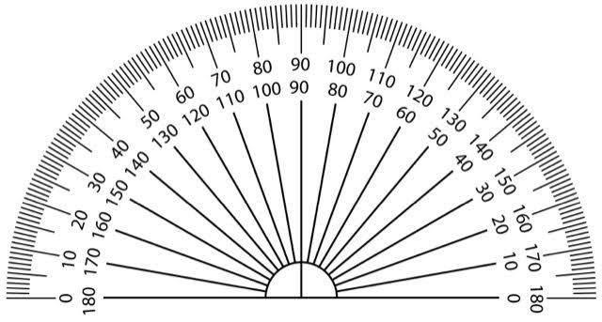
This logo has order five rotational symmetry.
What angle is the element rotated through each time?

Slide 2
This logo has order three rotational symmetry.
What angle is the element rotated through each time?

Slide 3
This logo has order six rotational symmetry.
What angle is the element rotated through each time?

Slide 4
This logo has order two rotational symmetry.
What angle is the element rotated through each time?

Slide 5
All of these logos have order two rotational symmetry.

Slide 6
What is the order of rotational symmetry for each logo.
What is the angle of turn in each logo?

