Slide 1
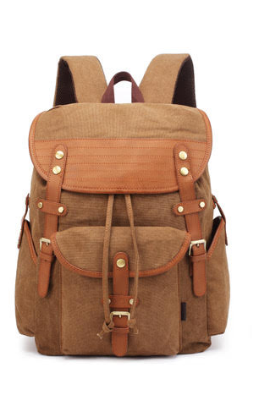
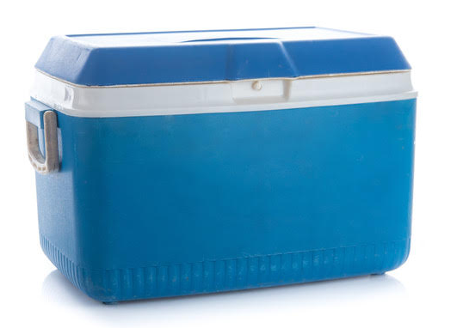
The volumes of some objects, such as backpacks and chilly bins, are sometimes given in units of L.
For example, a backpack might have a capacity of 40L, 50L, or 60L.
What does the ‘L’ mean?

Slide 2
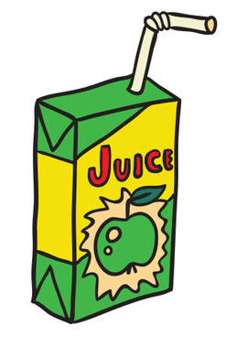
The Just Juice Company wants a new carton that will hold exactly 330 mL of juice.
Each side of the new carton must be an exact number of centimetres long (e.g. a side cannot be 4.75 cm long).

