Slide 1
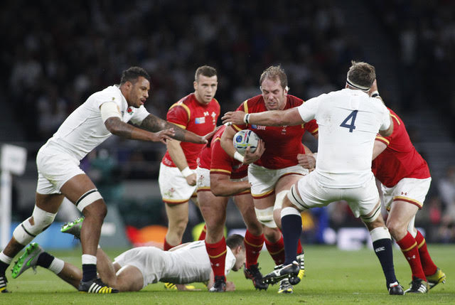
Can you predict the winning team?

Slide 2
I’ll look at the 23 players who will get on the field in the big games.
Some of the 31 players will only play one game in the whole tournament.

Slide 3
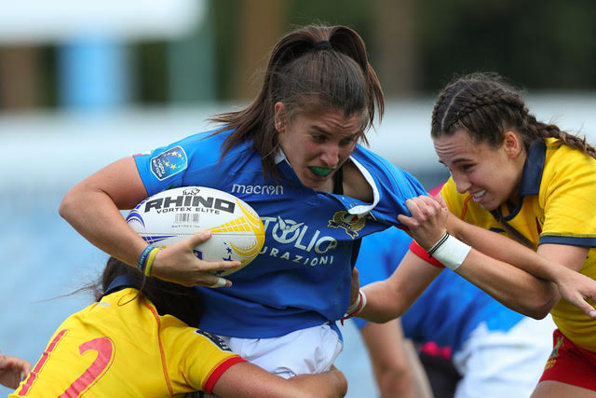
Experience is really important. I am going to look at age of the players, and number of caps they have.

Slide 4
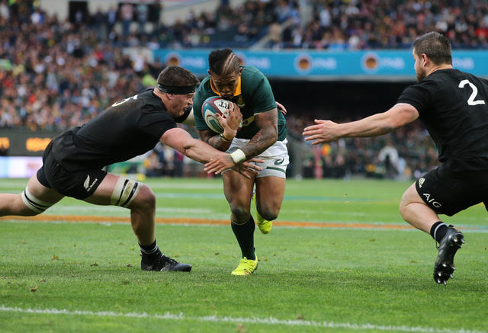
Players have to be big in rugby.
I’m going to look at weight and height.

Slide 5
Teams will win by scoring points. I will look at which teams have the highest point scorers.

Slide 6
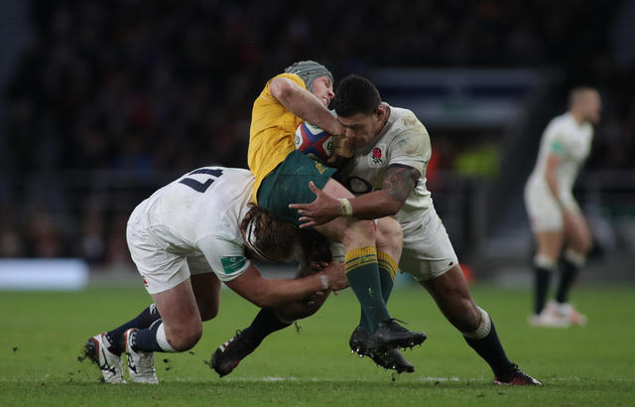
When it’s crunch time you need a good captain.
Who has the best captain?

