Slide 1
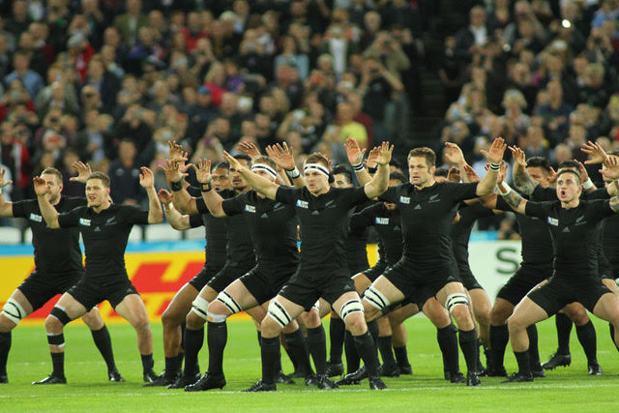
Can we win without Richie?

Slide 2
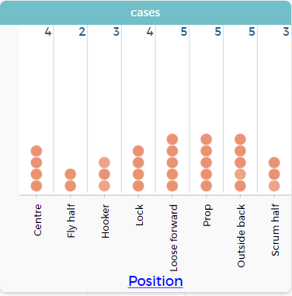
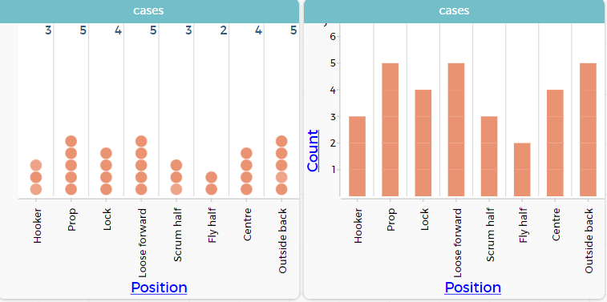
What is the distribution of player positions?

Slide 3
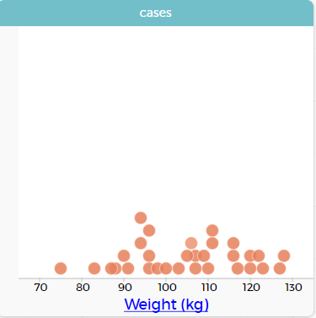
What are the weights of the All Black players?

Slide 4
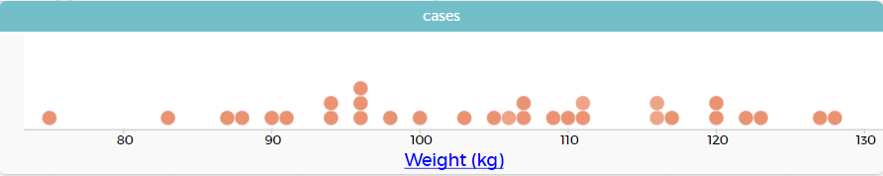
What are the weights of the All Black players?

Slide 5
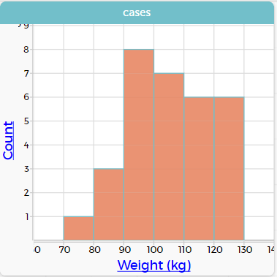
What are the weights of the All Black players?

Slide 6
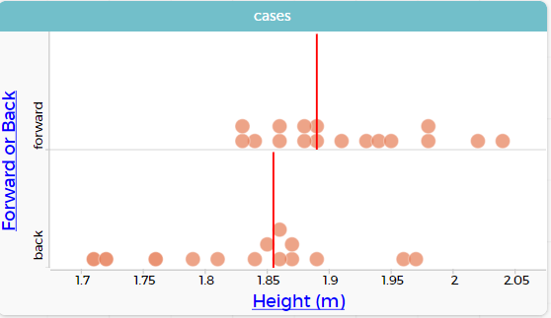
Do forwards tend to be taller than backs?

Slide 7
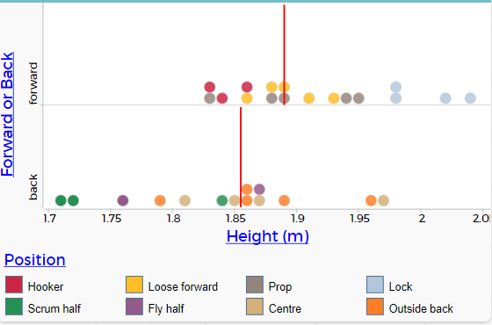
Do forwards tend to be taller than backs?

Slide 8
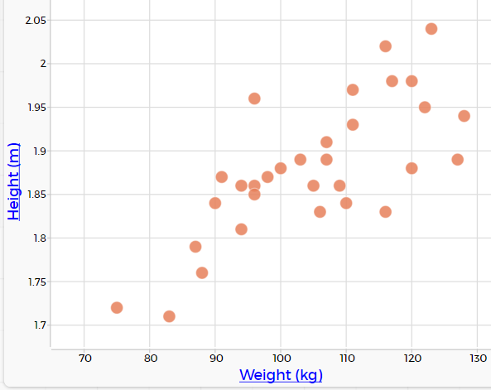
How are players’ weights related to their heights?

Slide 9
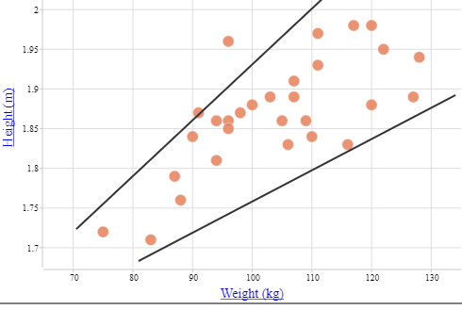
How are players’ weights related to their heights?

Slide 10
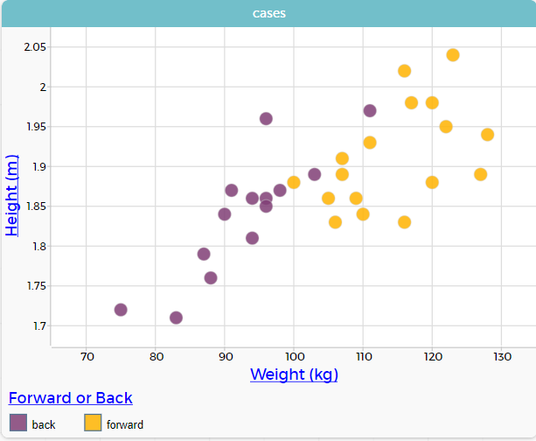
How are players’ weights related to their heights?

Slide 11
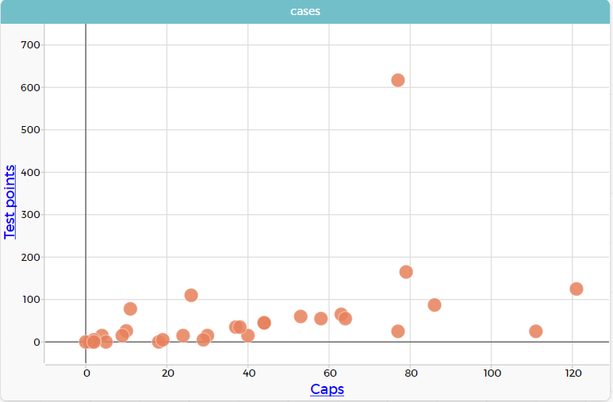
How are players’ total points related to their number of caps?

Slide 12
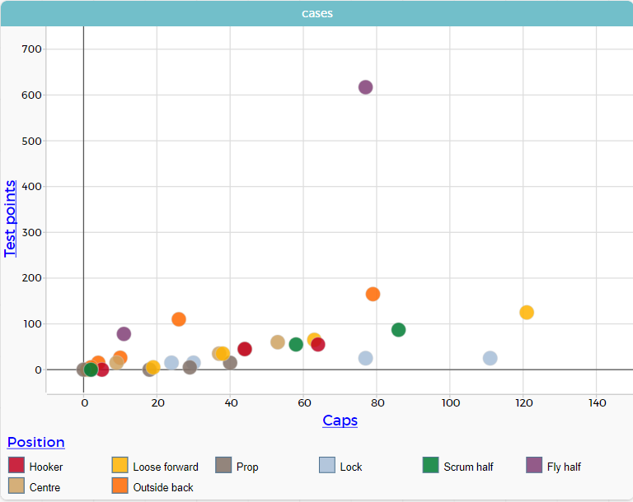
How are players’ total points related to their number of caps?

