Slide 1
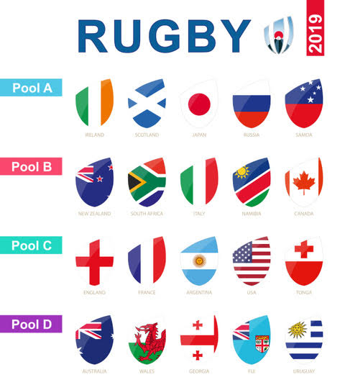

Slide 2
Pool A
5 teams
winner
Quarter Final 4
Men’s draw
Runners-up
Semi Final 2
Pool B
5 teams
Quarter Final 2
Final
winner
Semi Final 1
Pool C
5 teams
winner
Quarter Final 1
Runners-up
Pool D
5 teams
Quarter Final 3
winner

Slide 3
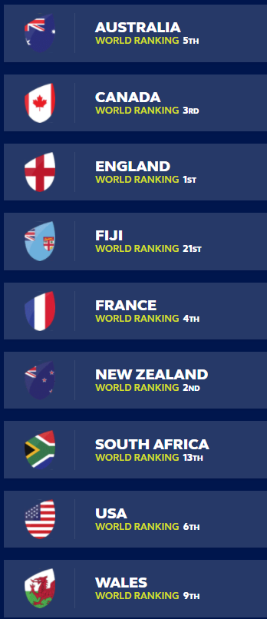
Women’s Rugby World Cup 2021
https://www.rugbyworldcup.com/2021
Correct as at: 29 November 2020

Slide 4
Pool A
4 teams
Quarter Final Seed 4 vs Seed 5
Semi-Final
Pool B
4 teams
Quarter Final Seed 3 vs Seed 6
Final
Quarter Final
Seed 2 vs Seed 7
Semi-Final
Pool C
4 teams
Quarter Final
Seed 1 vs Seed 8

Slide 5
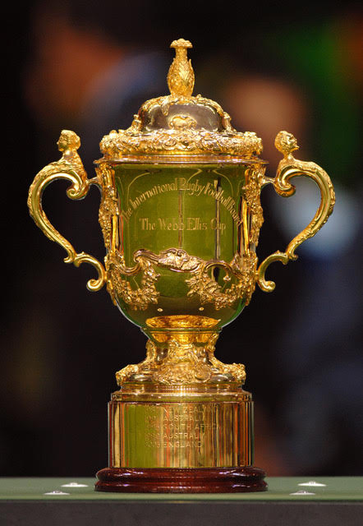
Who was William Webb Ellis?

