Slide 1
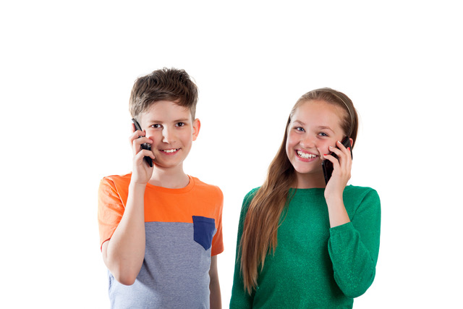
Ash is secretary of the debating club.
The club has 143 members, including Jacques.
He wants everyone to receive a one minute message but that would take him a long time.
So he phones Barb, that takes one minute.

Slide 2
In the next minute Ash phones Carl, and Barb phones Deena.
Then he is done. In Ash’s system, two is the maximum number of calls each person can make.
In the next minute Barb phones Elsa, and Carl phones Finn, and Deena phones Gaye. Then Barb is finished.
Zero minutes
Ash
1 minute
Barb
2 minutes
Deena
Carl
3 minutes
Elsa
Gaye
Finn

Slide 3
Draw the telephone tree for at least two more layers.
How many minutes will it take for all 143 members to get a call?
Show how you solved the problem.

Slide 4
Zero minutes
Ash
1 minute
Barb
2 minutes
Deena
Carl
3 minutes
Elsa
Gaye
Finn
4 minutes
Hone
Izzy
Joe
Katya
Lucy
5 minutes
Min
Nadine
Olive
Pounamu
Quentin
Ruka
Sam
Tyrese

Slide 5
5
8
8
13
13
21
21
34
34
55

Slide 6
Long side (L) | Short side (S) | Ratio (L ÷ S)
2 | 1 | 2
3 | 2 | 1.5
5 | 3
8 | 5
13 | 8
21 | 13
34 | 21
55 | 34
89 | 55

Slide 7
