Slide 1
Elsa is a property developer who builds affordable houses.
She is planning the layout of Fibonacci Street.

Slide 2
She has two ways to locate houses on her sections.
One house can be on a single section.
She calls this setup S, for obvious reasons.
Two houses can be joined on a double section.
She calls this setup D, for duplex.

Slide 3
Elsa works out that there are three different layouts on a row of three sections.
S, S, S
S, D
D, S

Slide 4
How many different layouts are there on a row of two sections?
S, S
D
How many different layouts are there on a row of four sections?

Slide 5
S, S, S, S
Stand alone
Stand alone
Stand alone
Stand alone
D, S, S
Duplex
Stand alone
Stand alone
S, D, S
Stand alone
Duplex
Stand alone
S, S, D
Stand alone
Stand alone
Duplex
D, D
Duplex
Duplex

Slide 6
Number of Sections | Layouts starting with S | Layouts starting with D | Total number of layouts
1 | S |  | 1
2 | S, S. | D | 2
3 | S, S, S. S, D. | D, S. | 3
4 | S, S, S, S. S, S, D. S, D, S. | D, S, S. D, D. | 5
5
S
D
S, S, S.
D, S.
S, D.
S, S, S, S.
D, S, S.
S, S, D.
D, D.
S, D, S.
S, S, S.
S,
S, S, S, S.
D,
D,
S,
S, S, D.
S, D.
D, S.
8
S,
S, D, S.
D,
S,
D, S, S.
S,
D, D.

Slide 7
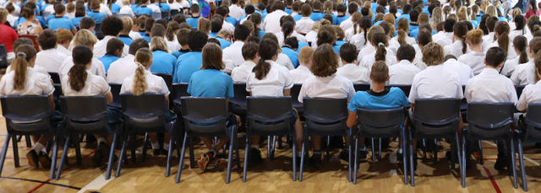
Your teacher is concerned about the lack of attention at assembly.
She has identified each student in your class as a talker or a listener.

Slide 8
Her plan is to not have any talkers sitting next to each other.
So in a row of three seats she might have:
but not…
or
or

Slide 9
A row at assembly has nine seats.
What is the maximum number of talkers that can be placed in a row, under your teacher’s rules.
How many different arrangements of nine talkers and listeners are possible?
How many of those nine arrangements follow your teacher’s rules?

