Slide 1
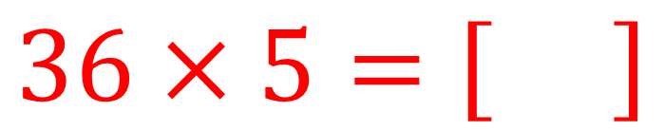

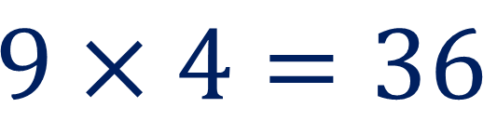
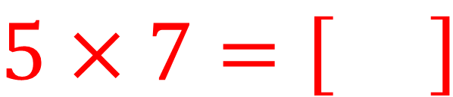
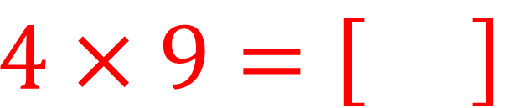
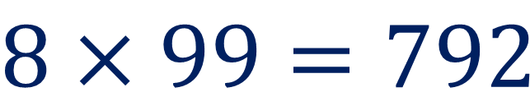


1
$7×5=35$
$$9×4=36$$
$$5×7=\left[ \right]$$
$$4×9=\left[ \right]$$
$$8×99=792$$
5 $×36=180$
$$99×8=\left[ \right]$$
$$36×5=\left[ \right]$$
What do you notice? What’s going on here?

Slide 2
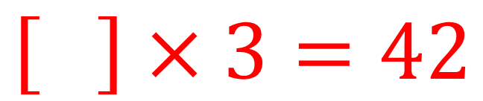

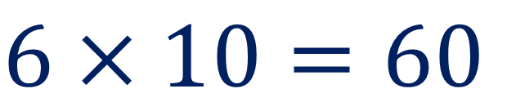
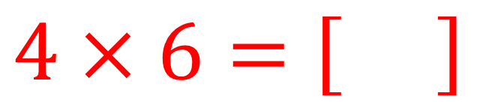

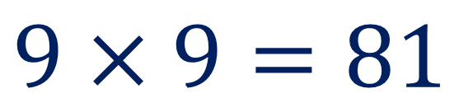
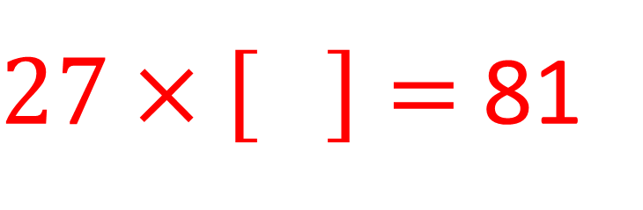
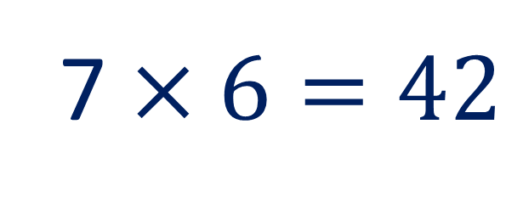
2
$8×3=24$
$$6×10=60$$
$$4×6=\left[ \right]$$
$$12×5=\left[ \right]$$
$$9×9=81$$
7 $×6=42$
$27×\left[ \right]=$81
$$\left[ \right]×3=42$$
What do you notice? What’s going on here?

Slide 3



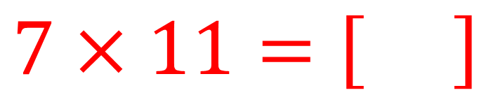
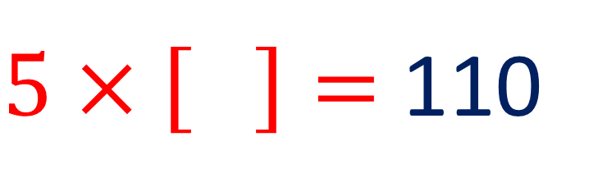
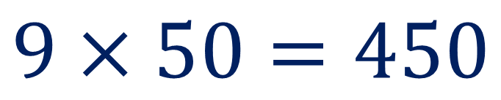
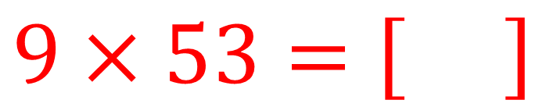
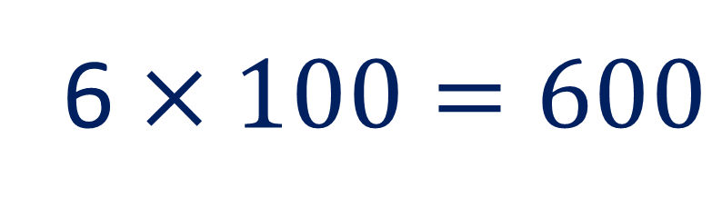
3
$7×10=70$
$$5×20=100$$
$$7×11=\left[ \right]$$
$5×\left[ \right]=$ 110
$$9×50=450$$
6 $×100=600$
$$9×53=\left[ \right]$$
$×105=630$
What do you notice? What’s going on here?

Slide 4
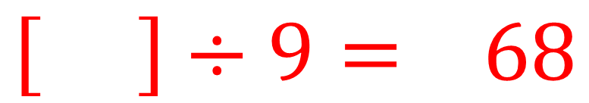

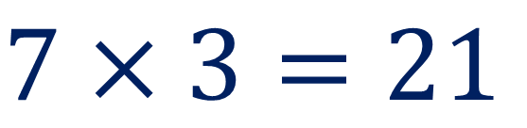
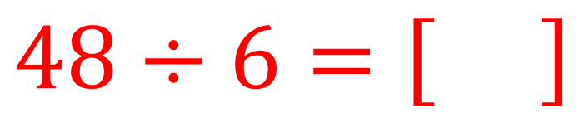
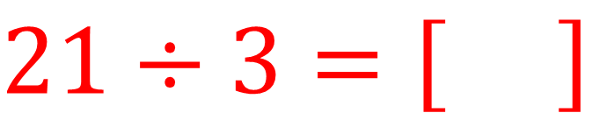

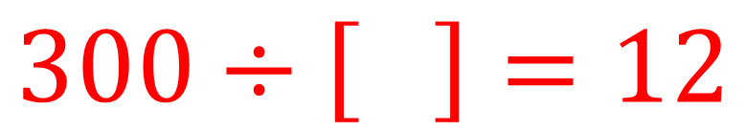
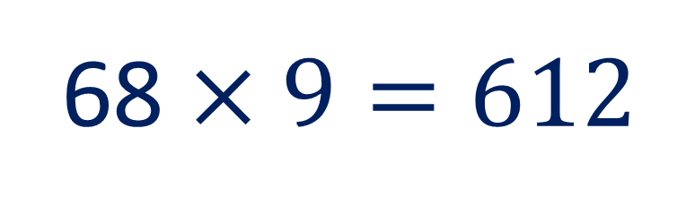
4
$8×6=48$
$$7×3=21$$
$$48÷6=\left[ \right]$$
$$21÷3=\left[ \right]$$
$$12×25=300$$
68 $×9=612$
$$300÷\left[ \right]=12$$
$$\left[ \right]÷9= 68$$
What do you notice? What’s going on here?

Slide 5
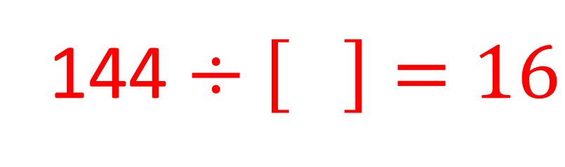


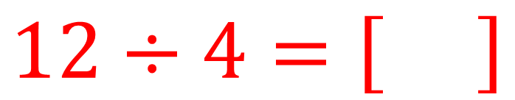

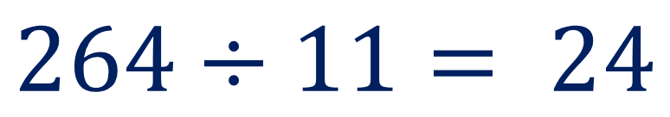
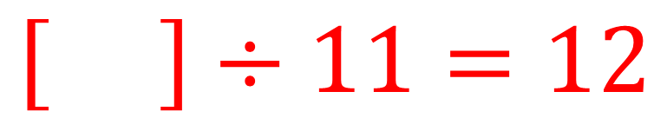
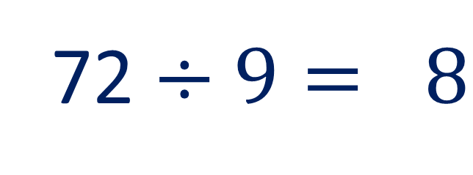
5
$24÷4= 6$
$$40÷5= 8$$
$$12÷4=\left[ \right]$$
$$20÷5=\left[ \right]$$
$$264÷11= 24$$
72 $÷9= 8$
$$\left[ \right]÷11=12$$
144 $÷\left[ \right]=16$
What do you notice? What’s going on here?

Slide 6
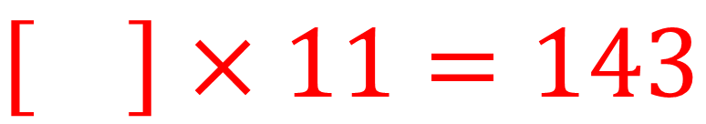
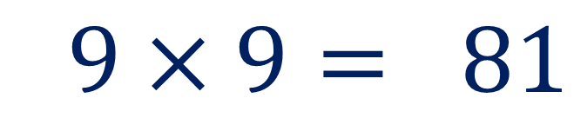

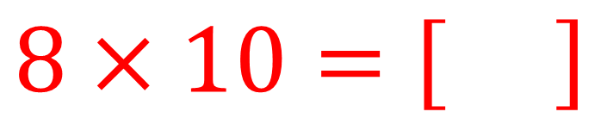
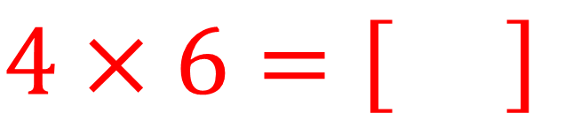

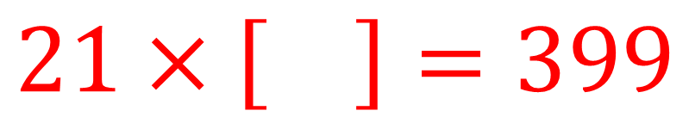
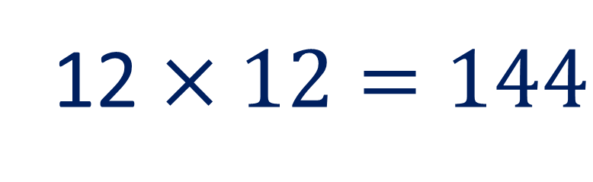
6
$9×9= 81$
$$5×5=25$$
$$8×10=\left[ \right]$$
$$4×6=\left[ \right]$$
$$20×20=400$$
12 $×12=144$
$$21×\left[ \right]=399$$
$×11=143$
What do you notice? What’s going on here?

Slide 7
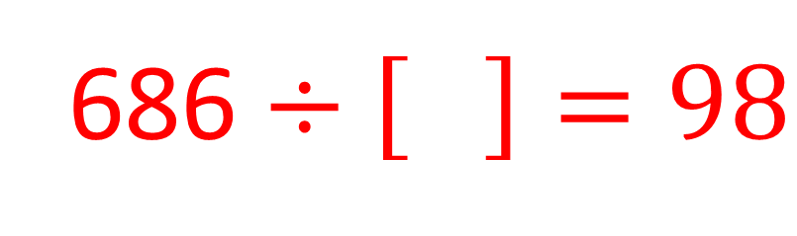


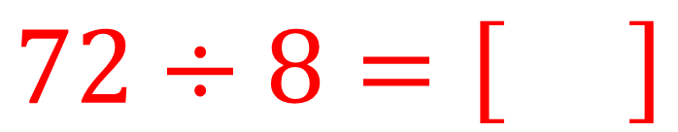
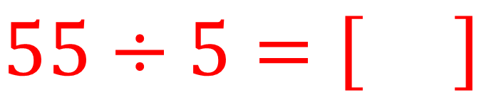

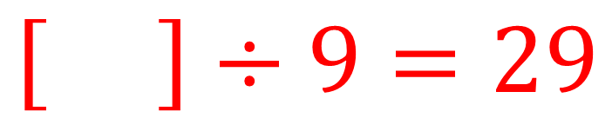
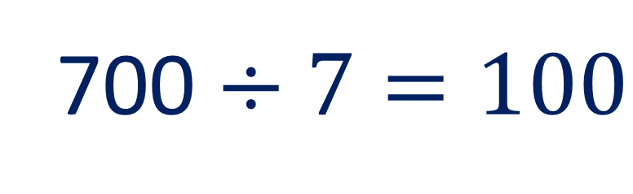
7
$80÷8= 10$
$$60÷5= 12$$
$$72÷8=\left[ \right]$$
$$55÷5=\left[ \right]$$
$$270÷9=30$$
700 $÷7=100$
$$\left[ \right]÷9=29$$
686 $÷\left[ \right]=98$
What do you notice? What’s going on here?

