Slide 1
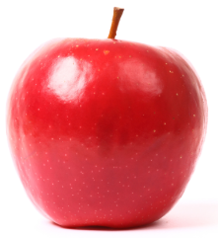
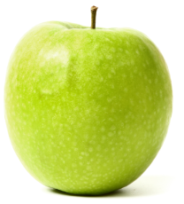
The rectangular stack is eight apples high.
How many apples are in the stack?

Slide 2
8
9
You might solve the problem this way.

Slide 3
36
36
You might solve the problem this way.

Slide 4
The rectangular stack is five apples high.
How many apples are in the stack?

Slide 5
5
6
You might solve the problem this way.

Slide 6
15
15
You might solve the problem this way.

Slide 7
The rectangular stack is eleven apples high.
How many apples are in each triangle?

Slide 8
If a triangular stack of apples is 25 apples wide, how many apples are in the whole stack?
If a triangular stack of apples is n apples wide, how many apples are in the whole stack?
3. 210 apples are used to make a triangular stack. How wide is the stack?

Slide 9
If a house-shaped stack of apples is 25 apples wide, how many apples are in the whole stack?
If a house-shaped stack of apples is n apples wide, how many apples are in the whole stack?

Slide 10
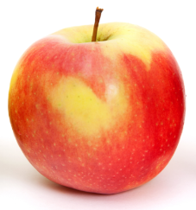
If a Greek cross array of apples is 25 apples along each side, how many apples are in the whole array?
If a Greek cross array contains 761 apples, how many apples are along each side?

Slide 11
What is the smallest number of apples that need to be moved to turn this triangular pattern into a square pattern?

